Slide 1
Amazon Web Services

Slide 2
AWS Platform
Your Applications
Management & Administration
Identity & Access
AWS IAM
Identity Federation
Consolidated Billing
Web Interface
Management Console
Monitoring
Amazon CloudWatch
Deployment & Automation
AWS Elastic Beanstalk
AWS CloudFormation
Application Platform Services
Content Distribution
Amazon CloudFront
Application Svcs
Simple Workflow Service
CloudSearch
Amazon SNS, SQS, SES
Parallel Processing
Elastic MapReduce
Libraries & SDKs
Java, PHP, Python,
Ruby, .NET
Foundation Services
Compute
Amazon EC2
Auto Scale
Storage
Amazon S3
Amazon EBS
Amazon StorageGateway
Database
Amazon RDS
Amazon SimpleDB
Amazon ElastiCache
Amazon DynamoDB
Networking
Amazon VPC Elastic Load Balancing
Amazon Route 53
AWS Direct Connect
Availability Zones
Edge Locations
AWS Global Infrastructure
Regions

Slide 3
AWS Platform
Your Applications
Management & Administration
Identity & Access
AWS IAM
Identity Federation
Consolidated Billing
Web Interface
Management Console
Monitoring
Amazon CloudWatch
Deployment & Automation
AWS Elastic Beanstalk
AWS CloudFormation
Application Platform Services
Content Distribution
Amazon CloudFront
Application Svcs
Simple Workflow Service
CloudSearch
Amazon SNS, SQS, SES
Parallel Processing
Elastic MapReduce
Libraries & SDKs
Java, PHP, Python,
Ruby, .NET
Foundation Services
Compute
Amazon EC2
Auto Scale
Storage
Amazon S3
Amazon EBS
Amazon StorageGateway
Database
Amazon RDS
Amazon SimpleDB
Amazon ElastiCache
Amazon DynamoDB
Networking
Amazon VPC Elastic Load Balancing
Amazon Route 53
AWS Direct Connect
Availability Zones
Edge Locations
AWS Global Infrastructure
Regions

Slide 4
Foundation Services
Your Applications
Management & Administration
Identity & Access
AWS IAM
Identity Federation
Consolidated Billing
Web Interface
Management Console
Monitoring
Amazon CloudWatch
Deployment & Automation
AWS Elastic Beanstalk
AWS CloudFormation
Application Platform Services
Content Distribution
Amazon CloudFront
Application Svcs
Simple Workflow Service
CloudSearch
Amazon SNS, SQS, SES
Parallel Processing
Elastic MapReduce
Libraries & SDKs
Java, PHP, Python,
Ruby, .NET
Foundation Services
Compute
Amazon EC2
Auto Scale
Storage
Amazon S3
Amazon EBS
Amazon StorageGateway
Database
Amazon RDS
Amazon SimpleDB
Amazon ElastiCache
Amazon DynamoDB
Networking
Amazon VPC Elastic Load Balancing
Amazon Route 53
AWS Direct Connect
Availability Zones
Edge Locations
AWS Global Infrastructure
Regions
Notes:
No Notes

Slide 5
Application Platform Services
Your Applications
Management & Administration
Identity & Access
AWS IAM
Identity Federation
Consolidated Billing
Web Interface
Management Console
Monitoring
Amazon CloudWatch
Deployment & Automation
AWS Elastic Beanstalk
AWS CloudFormation
Application Platform Services
Content Distribution
Amazon CloudFront
Application Svcs
Simple Workflow Service
CloudSearch
Amazon SNS, SQS, SES
Parallel Processing
Elastic MapReduce
Libraries & SDKs
Java, PHP, Python,
Ruby, .NET
Foundation Services
Compute
Amazon EC2
Auto Scale
Storage
Amazon S3
Amazon EBS
Amazon StorageGateway
Database
Amazon RDS
Amazon SimpleDB
Amazon ElastiCache
Amazon DynamoDB
Networking
Amazon VPC Elastic Load Balancing
Amazon Route 53
AWS Direct Connect
Availability Zones
Edge Locations
AWS Global Infrastructure
Regions
Notes:
No Notes

Slide 6
Management & Administration
Your Applications
Management & Administration
Identity & Access
AWS IAM
Identity Federation
Consolidated Billing
Web Interface
Management Console
Monitoring
Amazon CloudWatch
Deployment & Automation
AWS Elastic Beanstalk
AWS CloudFormation
Application Platform Services
Content Distribution
Amazon CloudFront
Application Svcs
Simple Workflow Service
CloudSearch
Amazon SNS, SQS, SES
Parallel Processing
Elastic MapReduce
Libraries & SDKs
Java, PHP, Python,
Ruby, .NET
Foundation Services
Compute
Amazon EC2
Auto Scale
Storage
Amazon S3
Amazon EBS
Amazon StorageGateway
Database
Amazon RDS
Amazon SimpleDB
Amazon ElastiCache
Amazon DynamoDB
Networking
Amazon VPC Elastic Load Balancing
Amazon Route 53
AWS Direct Connect
Availability Zones
Edge Locations
AWS Global Infrastructure
Regions
Notes:
The commitment to Amazon Web Services is also shown through the products offered.

Slide 7
Your Applications
Your Applications
Management & Administration
Identity & Access
AWS IAM
Identity Federation
Consolidated Billing
Web Interface
Management Console
Monitoring
Amazon CloudWatch
Deployment & Automation
AWS Elastic Beanstalk
AWS CloudFormation
Application Platform Services
Content Distribution
Amazon CloudFront
Application Svcs
Simple Workflow Service
CloudSearch
Amazon SNS, SQS, SES
Parallel Processing
Elastic MapReduce
Libraries & SDKs
Java, PHP, Python,
Ruby, .NET
Foundation Services
Compute
Amazon EC2
Auto Scale
Storage
Amazon S3
Amazon EBS
Amazon StorageGateway
Database
Amazon RDS
Amazon SimpleDB
Amazon ElastiCache
Amazon DynamoDB
Networking
Amazon VPC Elastic Load Balancing
Amazon Route 53
AWS Direct Connect
Availability Zones
Edge Locations
AWS Global Infrastructure
Regions

Slide 8
10 AWS Regions
51 AWS Edge Locations
Notes:
Just added Taipei and Rio De Janero

Slide 9
Regions
US East (VA)
US West (CA)
Asia Pacific (Tokyo)
Asia Pacific (Singapore)
Asia Pacific (Sydney)
Availability Zone A
Availability Zone B
Availability Zone A
Availability Zone B
Availability Zone A
Availability Zone B
Availability Zone A
Availability Zone B
Availability Zone A
Availability Zone B
Availability Zone C
Availability Zone D
Availability Zone C
US West (OR)
EU (Ireland)
South America (Sao Paulo)
EU (Frankfurt)
Availability Zone A
Availability Zone B
Availability Zone A
Availability Zone B
Availability Zone A
Availability Zone B
Availability Zone A
Availability Zone B
Availability Zone C
Availability Zone C
Availability Zone C
GovCloud (OR)
Asia Pacific (Seoul)
Asia Pacific (Mumbai)
Availability Zone A
Availability Zone B
Availability Zone A
Availability Zone B
Availability Zone A
Availability Zone B
Availability Zone C

Slide 10
Your Applications
Management & Administration
Identity & Access
AWS IAM
Identity Federation
Consolidated Billing
Web Interface
Management Console
Monitoring
Amazon CloudWatch
Deployment & Automation
AWS Elastic Beanstalk
AWS CloudFormation
Application Platform Services
Content Distribution
Amazon CloudFront
Application Svcs
Simple Workflow Service
CloudSearch
Amazon SNS, SQS, SES
Parallel Processing
Elastic MapReduce
Libraries & SDKs
Java, PHP, Python,
Ruby, .NET
Foundation Services
Compute
Amazon EC2
Auto Scale
Storage
Amazon S3
Amazon EBS
Amazon StorageGateway
Database
Amazon RDS
Amazon SimpleDB
Amazon ElastiCache
Amazon DynamoDB
Networking
Amazon VPC Elastic Load Balancing
Amazon Route 53
AWS Direct Connect
Availability Zones
Edge Locations
AWS Global Infrastructure
Regions
Notes:
No Notes

Slide 11
Compute
Elastic Compute Cloud (EC2)
Amazon Machine Image (AMI)
Autoscaling
Notes:
No notes

Slide 12
Amazon EC2
Elastic Compute Cloud

Slide 13
What is EC2?

Slide 14
EC2 - Introduction
Amazon Elastic Compute Cloud (Amazon EC2)
EC2 Instances = Virtual Servers
Resizable compute capacity in 29 instance types
Reduces the time required to obtain and boot new server instances to minutes or seconds
Scale capacity as your computing requirements change
Pay only for capacity that you actually use
Choose Linux or Windows
Deploy across Regions and Availability Zones for reliability
Flexible networking (NAT/classic, VPC, Elastic IPs)
Support for virtual network interfaces that can be attached to EC2 instances in your VPC
Notes:
Amazon EC2 presents a true virtual computing environment, allowing you to use web service interfaces to launch instances with a variety of operating systems, load them with your custom application environment, manage your network’s access permissions, and run your image using as many or few systems as you desire.
To use Amazon EC2, you simply:
Select a pre-configured, templated Amazon Machine Image (AMI) to get up and running immediately. Or create an AMI containing your applications, libraries, data, and associated configuration settings.
Configure security and network access on your Amazon EC2 instance.
Choose which instance type(s) you want, then start, terminate, and monitor as many instances of your AMI as needed, using the web service APIs or the variety of management tools provided.
Determine whether you want to run in multiple locations, utilize static IP endpoints, or attach persistent block storage to your instances.
Pay only for the resources that you actually consume, like instance-hours or data transfer.

Slide 15

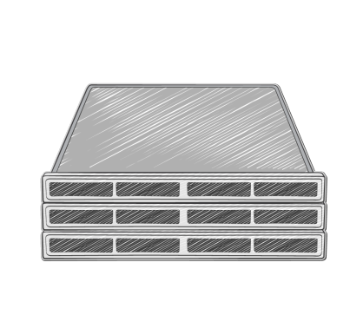
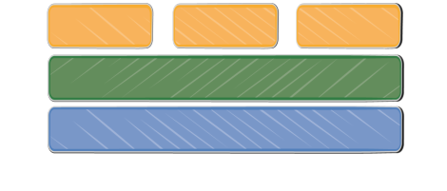
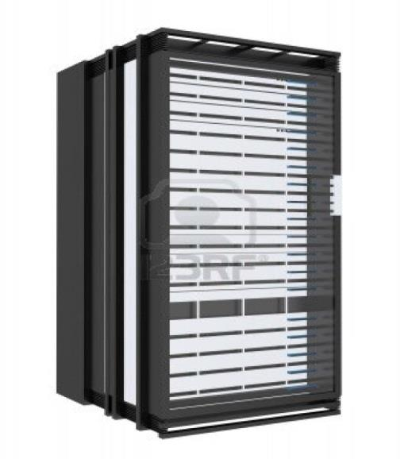
EC2
Elastic virtual servers in the cloud
Guest 1
Guest
2
Guest
n
Hypervisor
Host server
Server rack

Slide 16

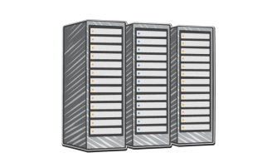
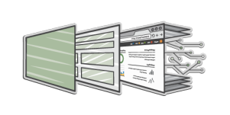

EC2
Purchase options
Virtual machines
User experience
Networking
EC2
EC2

Slide 17
EC2Benefits
Elasticity
Completely Controlled
Flexibility
Breadth of Functionality
Realibility
Security
Cost Effectiveness
Scalability

Slide 18
Elasticity

Slide 19

Traditional capacity required
Capacity of 1 server
Server load
0
1
2
3
4
5
6
7
8
9 10 11 12 13 14 15 16 17 18 19 20 21 22 23 24
Hour of day

Slide 20
Traditional capacity required
Capacity of 1 server
Server load
0
1
2
3
4
5
6
7
8
9 10 11 12 13 14 15 16 17 18 19 20 21 22 23 24
Hour of day

Slide 21
Traditional capacity required
Capacity of 1 server
Server load
0
1
2
3
4
5
6
7
8
9 10 11 12 13 14 15 16 17 18 19 20 21 22 23 24
Hour of day

Slide 22


Traditional capacity required
Capacity of 1 server
Server load
1 server for 8 hours
0
1
2
3
4
5
6
7
8
9 10 11 12 13 14 15 16 17 18 19 20 21 22 23 24
Hour of day

Slide 23
Traditional capacity required
Capacity of 1 server
Server load
1 server for 8 hours
1 server for 8 hours
0
1
2
3
4
5
6
7
8
9 10 11 12 13 14 15 16 17 18 19 20 21 22 23 24
Hour of day

Slide 24
Traditional capacity required
1 server for 8 hours
Capacity of 1 server
Server load
1 server for 8 hours
1 server for 8 hours
0
1
2
3
4
5
6
7
8
9 10 11 12 13 14 15 16 17 18 19 20 21 22 23 24
Hour of day

Slide 25
Traditional capacity required
1 server for 8 hours
Capacity of 1 server
Server load
1 server for 8 hours
1 server for 8 hours
1 server for 8 hours
0
1
2
3
4
5
6
7
8
9 10 11 12 13 14 15 16 17 18 19 20 21 22 23 24
Hour of day

Slide 26





Capacity of 1 server
Server load
1/3
rd
saving
0
1
2
3
4
5
6
7
8
9 10 11 12 13 14 15 16 17 18 19 20 21 22 23 24
Hour of day

Slide 27


6
5
4
Instance count
3
2
1
0
0
2
4
6
8
10
12
18
Day of month
14
16
20
22
24
26
28
30

Slide 28

6
5
Monthly
predictable
peak
processing
4
Instance count
3
2
1
0
0
2
4
6
8
10
12
18
Day of month
14
16
20
22
24
26
28
30

Slide 29
Traditional capacity required
6
5
4
Instance count
3
2
1
0
0
2
4
6
8
10
12
18
Day of month
14
16
20
22
24
26
28
30

Slide 30


Traditional capacity required
6
5
4
Instance count
3
2
1
Elastic capacity
0
0
2
4
6
8
10
12
18
Day of month
14
16
20
22
24
26
28
30

Slide 31



Traditional capacity required
6
5
4
75% savings
Instance count
3
2
1
Elastic capacity
0
0
2
4
6
8
10
12
18
Day of month
14
16
20
22
24
26
28
30

Slide 32







Scaling automatically
EC2
Auto Scaling
ELB
Elastic virtual servers
in the cloud
Automated scaling
of EC2 capacity
Dynamic traffic
distribution
EC2
Actual

Slide 33
Completely Controlled

Slide 34
Completely Controlled
You have control of your instances
Log on as root (Linux)/Administrator (Windows)
Install the software you need
Start/stop and control instances with console or APIs
Make the configuration changes you like
Create an AMI (Amazon Machine Image)

Slide 35
Flexibility

Slide 36
Multiple EC2 Instance Types
Choose the instance type that suits you
Change the instance type when you want to
Attach as much or as little storage as you need
Choose your operating system
Choose a pre-configured image (AMI)

Slide 37
Cluster High Memory & High Storage
256
128
64
32
16
8
4
2
1
 | 1 | 2 | 4 | 8 | 16 | 32 | 64 | 128
High Memory
Cluster Compute
& High I/O
Memory (GB)
Standard
High CPU
Micro
EC2 Compute Units (HP)
Notes:
EC2 Instances come in 14 different types from Micro instance al the way up to the Cluster Compute and High I/O instances. We have also grouped the instance types into traditional configurations whether it is High Memory instances for Databases or High CPU for workloads with high computational needs. The standard instance types are configured to be the workhorses of your application… like a web tier frontend.

Slide 38
EC2 instances: Families and Generations
General-purpose:
M1, M3 , T2
Compute-optimized:
C1, CC2, C3, C4
Memory-optimized:
M2, CR1, R3
Dense-storage:
HS1, D2
I/O-optimized:
HI1, I2
GPU:
CG1, G2
Micro:
T1, T2

Slide 39

EC2 instances: Sizes

Slide 40




EC2 instances: Types
Instance generation
c4.large
Instance family
Instance size

Slide 41
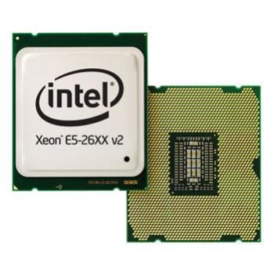


Performance factors: CPU
Intel Xeon E5-2670 (Sandy Bridge) CPUs
•
Available
on M3
,
CC2,
CR1,
and G2
instance
types
Intel Xeon E5-2680 v2 (Ivy Bridge) CPUs
•
Available on C3, R3, and I2 instance types
•
2.8 GHz in C3, Turbo enabled up to 3.6 GHz
•
Supports Enhanced Advanced Vector
Extensions
(AVX)
instructions
Intel Xeon E5-2666 v3 (Haswell – AVX2) CPUs
•
Available
on C4
instance types
•
2.9 GHz
in
C4,
Turbo enabled up to
3.5 GHz
(with
Intel
Turbo Boost)
Supports
vectors and can process 32
double-precision floating-point operations per cycle
•
256
-
bit
integer
single
-
precision 16 or

Slide 42
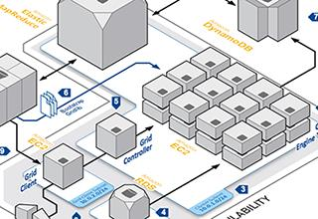
Performance factors: Networks
AWS proprietary 10Gb networking
•
Highest
performance in .8xlarge instance
sizes
•
Full
bi
-
section bandwidth in placement groups
•
No network oversubscription
Enhanced Networking
•
Available on D2, C3, C4, R3, I2 (in VPC with HVM)
Over 1M PPS performance, reduced instance
to
instance latencies, more consistent performance
•
-
-

Slide 43
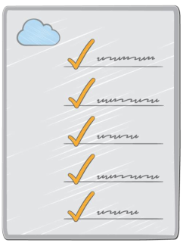
Tip: Use Enhanced Networking
• Available on D2, C4, C3, R3, I2 instance families
• HVM virtualization type
• VPC-only
• Required kernel version
– Linux: 2.6.32+
– Windows: Server 2008 R2+
• Appropriate virtual function driver
– Linux: ixgbevf 2.14.2+ module
– Windows: Intel 82599 virtual function driver

Slide 44
Performance factors: Storage
Locally attached or “instance storage”
Amazon EBS General Purpose (SSD) volumes
Amazon EBS Provisioned IOPS (SSD) volumes
Amazon EBS Magnetic volumes
S3/Glacier

Slide 45
Reliability

Slide 46
Build reliable architectures
Easily build highly available applications
ELB distributes load
Auto Scaling helps ensure availability and scale
Use multiple Availability Zones (AZs)

Slide 47
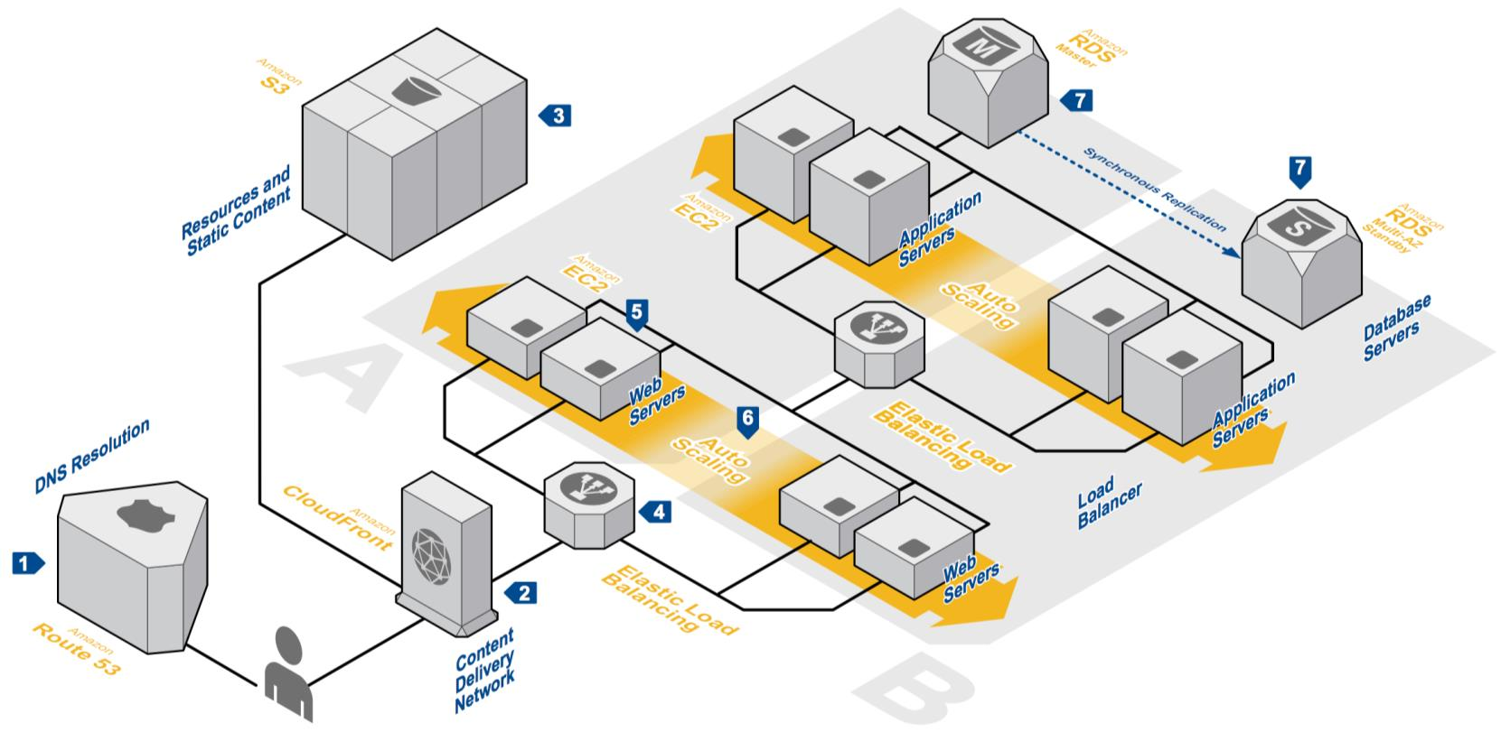
Example: 3-tier web application architecture

Slide 48
Security

Slide 49
VPC - Virtual Private Cloud
• Provision a logically isolated section of the AWS cloud
• Control your virtual networking environment with:
– Subnets
– Route tables
– Security groups
– Network ACLs
• Control if and how your instances access the Internet
• Connect to your on-premises network via a hardware
VPN or Direct Connect

Slide 50





















Internet
Internet Gateway
VPC Subnet
VPC Subnet
10.0.0.5
10.0.1.6
10.0.1.5
VPC Subnet
10.0.0.6
10.0.1.8
10.0.3.5
10.0.1.25
10.0.3.17
Availability Zone 1a
Virtual Private Gateway
Availability Zone 1b
VPN Connection
Customer Gateway
Customer Data Center

Slide 51
Cost Effectiveness

Slide 52
Purchase options that fit your workloads
On-Demand
Reserved
Spot
Pay for compute
capacity by the
hour with no long-
term commitments
Make an EC2
usage commitment
and receive a
significant
discount.
Bid for unused
capacity, charged
at a Spot Price
which fluctuates
based on supply
and demand
For spiky
workloads, or to
define needs
For committed
utilization
For time-
insensitive or
transient
workloads

Slide 53

Reserved Instance Payment Options
The
option provides a
discount compared to On-Demand
(up to 55% off) and does not require
an upfront payment
•
No Upfront
m3.xlarge 1yr OD/RI break even utilization
$3,000
$2,500
$2,000
On Demand
The
$1,500
option balances
the payments of a Reserved Instance
between upfront and hourly and
provides a higher discount (up to
76%) compared to the No Upfront
option
•
Partial Upfront
No Upfront
$1,000
Partial Upfront
$500
All Upfront
$-
30%
40%
50%
60%
70%
80%
90% 100%
Utilization
With
you
benefit from the highest discount
compared to On-Demand (up to 77%
off)
•
the
All
Upfront
option

Slide 54

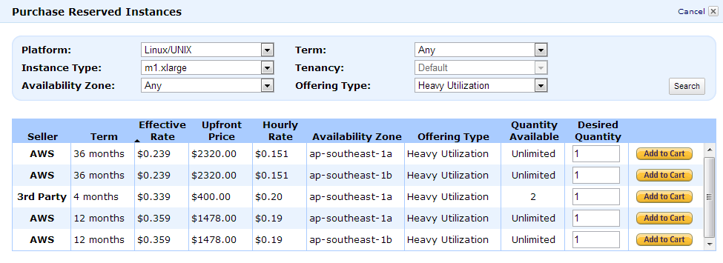
Reserved Instance Marketplace
Buy a smaller-term instance
Buy an instance with different OS or type
Buy a Reserved Instance in different region
Sell your unused Reserved Instance
Sell unwanted or over-bought capacity
Further reduce costs by optimizing

Slide 55
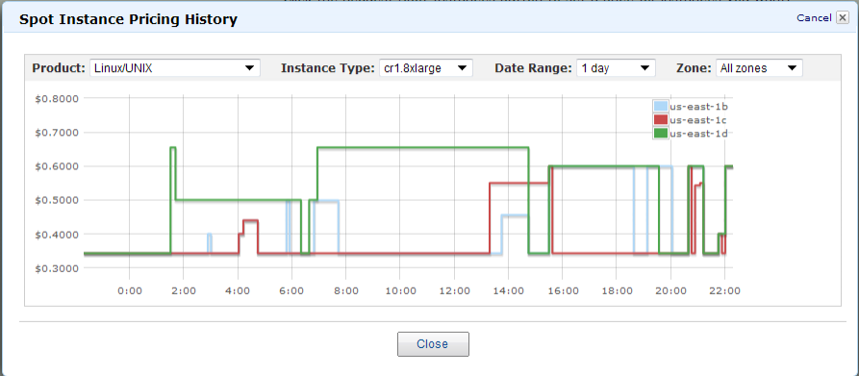
Spot for interruptible workloads and best pricing
Best Spot use-cases include any batch-oriented, fault-tolerant application

Slide 56
EC2 Free Instances
T2 is Burstable performance instance
Burstable performance instances provide a baseline level of CPU performance with the ability to burst above the baseline
T2 instances are for workload that don’t use the full CPU often or consistently but occasionally need to burst
Great for getting started on EC2
EC2 Free Tier
750 hours of EC2 Linux t2.micro instance usage (1 GiB of memory and 32-bit and 64-bot platform support )

Slide 57
Demo

Slide 58
Exercises
Follow lab material

Slide 59
Amazon EBS
Elastic Block Store

Slide 60
Elastic Block Store (EBS)
EBS Volumes = Virtual Disks
Use for persistent storage
Can use to create RAID configuration for a server
Off-instance block storage that persists independently
Storage volumes for use with Amazon EC2 instances – create, attach, backup, restore and delete
Can be attached to a running Amazon EC2 instance and exposed as a block device for raw or formatted (filesystem) access
Volumes behave like unformatted block devices for Linux or Windows instances
Ideas use cases:
OS Boot device / root file system; secondary volumes/filesystems
Typical basis for database storage
Raw block devices for RAID, some databases
Notes:
Block storage volumes for use with Amazon EC2 instances
Attach to running instance and expose as a block device
Off-instance storage that persists independently of EC2 instances
Snapshots stored durably in S3
Block level device – like SAN. Format or encrypt however you like. Run RAID across multiple volumes for better I/O performance

Slide 61
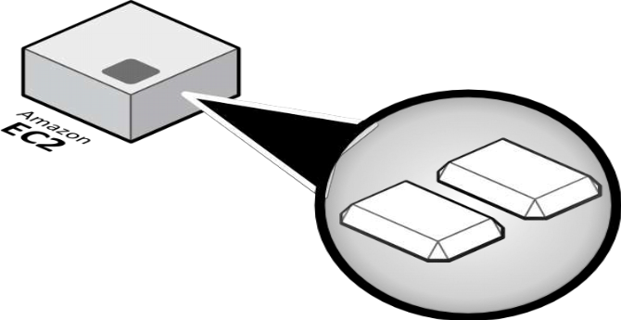
Ephemeral storage is on every EC2 instance

Slide 62
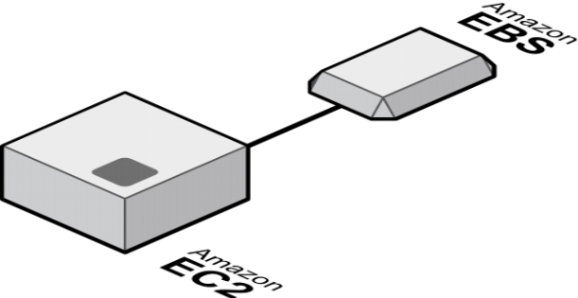
EBS volumes attach to EC2 instances

Slide 63
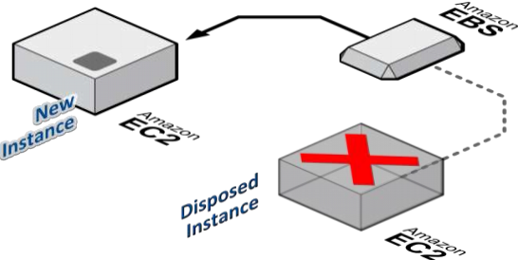
EBS volumes persist and can be attached to other instances

Slide 64
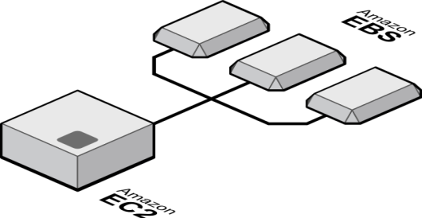
Multiple drives on one Amazon EC2 Instance

Slide 65
EBS
Can be attached to only one server
Multiple volumes can be attached to one server
Each volume Upto 2TB
Can be attached / detached from the server while running except root device
Create snapshots for backup
Types
Magnetic
General Purpose SSD
Provisioned IOPS SSD

Slide 66
Workloads on EBS Provisioned IOPS
P-IOPS is designed to run transactional applications that require high and consistent IO such as:
Relational databases
NoSQL databases ( e.g. MongoDB )
High performance file systems
Productivity applications (e.g. Microsoft Exchange)
Enterprise applications (e.g. CRM, ERP)

Slide 67
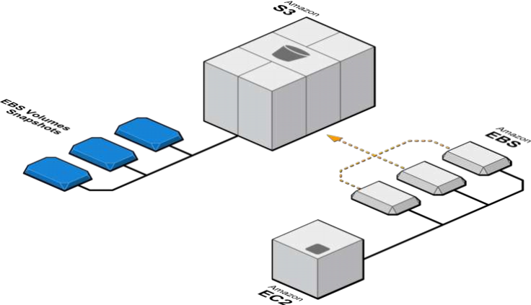
EBS - Snapshots

Slide 68
Use Amazon EBS When You Need
Filesystem for an instance NTFS, ExtFS, RAID, LVM
Long-term persistent storage
Ability to change data frequently
Access to raw, unformatted block-level storage

Slide 69
Amazon Machine Image
Virtual machine templates

Slide 70
Amazon Machine Image ( AMI )
Building blocks of EC2 instances
An AMI is like a template of a computer's root volume.
Can be public or private
Create hardened or gold “Images” of your EC2 infrastructure
Notes:
Amazon EC2 presents a true virtual computing environment, allowing you to use web service interfaces to launch instances with a variety of operating systems, load them with your custom application environment, manage your network’s access permissions, and run your image using as many or few systems as you desire.
To use Amazon EC2, you simply:
Select a pre-configured, template Amazon Machine Image (AMI) to get up and running immediately. Or create an AMI containing your applications, libraries, data, and associated configuration settings.
Configure security and network access on your Amazon EC2 instance.
Choose which instance type(s) you want, then start, terminate, and monitor as many instances of your AMI as needed, using the web service APIs or the variety of management tools provided.
Determine whether you want to run in multiple locations, utilize static IP endpoints, or attach persistent block storage to your instances.
Pay only for the resources that you actually consume, like instance-hours or data transfer.

Slide 71
Amazon ELB
Elastic Load Balancer

Slide 72
Elastic Load Balancer (ELB )
Supports the routing and load balancing of HTTP, HTTPS and generic TCP traffic to EC2 instances
Supports health checks to ensure detect and remove failing instances
Dynamically grows and shrinks required resources based on traffic
Seamlessly integrates with Auto-scaling to add and remove instances based on scaling activities
Single CNAME provides stable entry point for DNS configuration
Notes:
Elastic Load Balancing automatically distributes incoming application traffic across multiple Amazon EC2 instances. It enables you to achieve even greater fault tolerance in your applications, seamlessly providing the amount of load balancing capacity needed in response to incoming application traffic. Elastic Load Balancing detects unhealthy instances within a pool and automatically reroutes traffic to healthy instances until the unhealthy instances have been restored. Customers can enable Elastic Load Balancing within a single Availability Zone or across multiple zones for even more consistent application performance. Elastic Load Balancing can also be used in an Amazon Virtual Private Cloud (“VPC”) to distribute traffic between application tiers.

Slide 73
ELB - Overview
Distribute Incoming
Application Traffic
AWS Elastic
Load
Balancer
Identify Bad
EC2 Instances
Perform Health Checks
on EC2 Instances

Slide 74



ELB - Load Distribution
i
i
ii
ii
iii
Incoming
Application Traffic
Incoming
Application Traffic
iii
xxx
Distributes incoming traffic to backend Instances such that the load is distributed evenly.

Slide 75

ELB - Load Distribution
i
ii
i
AZ - I
ii
i
iii
ii
AZ - I
AZ -I I
Region
Region
ELBs Distribute Traffic to Multiple Instances in a Single
Availability Zone (AZ)or in Multiple Availability Zone.

Slide 76
ELB – Support Protocols
HTTP
ELB Supported
Protocols
HTTPS
TCP
SSL

Slide 77



AWS CloudWatch
How & what is my
cloud doing?
Monitoring System
MONITORING
WILL TELL YOU

Slide 78


What is AWS CloudWatch?
Metrics
Alarms
Amazon CloudWatch provides monitoring for AWS cloud resources and the applications customers run on AWS...

Slide 79


Collect data
Visualize
Monitoring
Act!

Slide 80
Collect data
Visualize
Monitoring
Act!

Slide 81












Amazon EC2
Auto Scaling
Elastic Load
Balancing
Amazon EMR
Amazon EBS
AWS Storage Gateway
CloudWatch
Amazon RDS
DynamoDB
ElastiCache
Amazon SNS
Amazon SQS
Notes:
Cloudwatch can collect the data from all these resources
E2- CPU, memory, network utilization, disk IO reads/writes etc..
ELB – Number of healthy hosts, unhealthy hosts, http error codes

Slide 82
Metrics - EC2
CPUUtilization
MemoryUtilization
NetworkIn
NetworkOut
DiskReadBytes
DiskWriteBytes
etc..

Slide 83
Metrics - RDS
CPUUtilization
DatabaseConnections
FreeStorageSpace
FreeableMemory
ReadIOPS
ReadLatency
etc..

Slide 84
Time Series Data (TSD)
A time series is a sequence of data points, measured typically at successive points in time spaced at uniform time intervals.
Forecasting, Estimation, Classification, Anomaly Detection

Slide 85
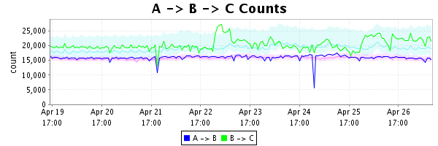
Time Series Data (TSD)
API calls, ad views, game play data, application usage, checkouts, boxes shipped, robot activity, customer happiness!
Data that describes an application's performance and behavior.

Slide 86
Datapoints
2016-05-27 18:00:00, 0.00
2016-05-27 18:01:00, 3.40
2016-05-27 18:02:00, 5.06
2016-05-27 18:03:00, 7.70
2016-05-27 18:04:00, 4.70
2016-05-27 18:05:00, 0.00
2016-05-27 18:06:00, 13.40
2016-05-27 18:07:00, 5.06
2016-05-27 18:08:00, 27.70

Slide 87
Datapoints
Datapoint
2016-05-27 18:00:00, 0.00
2016-05-27 18:01:00, 3.40
2016-05-27 18:02:00, 5.06
2016-05-27 18:03:00, 7.70
2016-05-27 18:04:00, 4.70
2016-05-27 18:05:00, 0.00
2016-05-27 18:06:00, 13.40
2016-05-27 18:07:00, 5.06
2016-05-27 18:08:00, 27.70

Slide 88
Collect data
Visualize
Monitoring
Act!

Slide 89
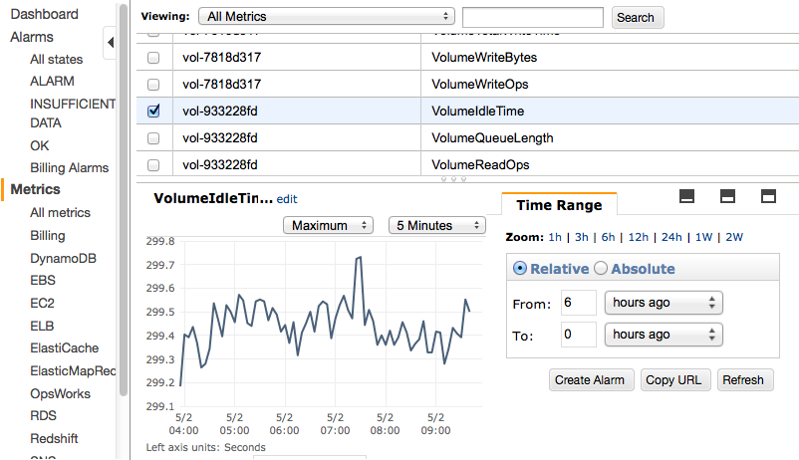
AWS CloudWatch Metrics

Slide 90
Collect data
Visualize
Monitoring
Act!

Slide 91
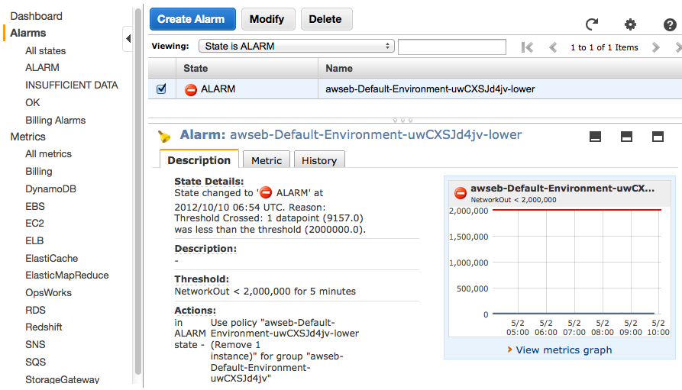
AWS CloudWatch Alarms

Slide 92
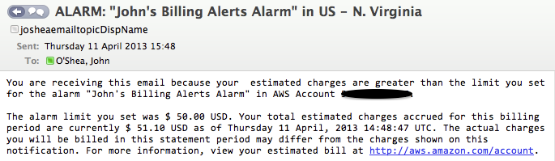
AWS CloudWatch Alarms
Example Use Cases
EC2: Tell me if my instance needs attention
DynamoDB: Help me balance cost and performance
Billing: Tell me when I'm exceeding my AWS budget

Slide 93
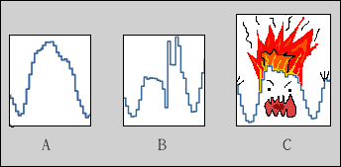
Inside
1 datapoint per metric, per minute, per resource
AWS is VERY big, VERY dynamic, growing VERY fast!
Aggregating data to produce meaningful statistics
What is CPU utilization across my fleet?
Today it is 50% - Yay!
Yesterday it was 25% – Huh?!
Last week it was 5% – Yikes?!

Slide 94
Inside
Data Access Patterns
Realtime data can be VERY valuable to wide audiences – ‘Million Dollar Minutes’
LOTS of older data, that might still be VERY valuable to narrow audiences
Be the Last Man Standing
What happens when there is a power event in a DC?
Who watches the watchmen?

Slide 95

CloudWatch free tier
‘Five-minute’ metrics on AWS resources
10 custom metrics, 10 alarms and 1 million API requests each month
Go PLAY!
aws.amazon.com/cloudwatch/

Slide 96
AWS Autoscaling
Scale your application infrastructure dynamically

Slide 97
What is Autoscaling
In a traditional server space hosting any application, the volume of data traffic always varies in strength, sometimes in a predictable manner, and sometimes erratically.
To deal with the increased traffic, the developer would either add machines or increase the compute capability of the existent machines. This is essentially what scaling means in a physical server space.
In the case of AWS, where your server is located in the cloud, this is simplified further, and we shall now see how it is done.

Slide 98
Compute - Autoscaling
Auto Scaling
Client Defined Business Rules
Scale your Amazon EC2 capacity automatically once you define the conditions (may be 1000’s of servers)
Can scale up just a little…doesn’t need to be massive number of servers (may be simply 2 servers)
Well suited for applications that experience variability in usage
Set minimum and maximum scaling policies
Can be used for high availability
Notes:
Auto Scaling is a type of “policy” into which you launch instances. Specify a min and max number of instances you would like launched into each AZ
Forcing function – keep a server up at al time or make sure there is at least 1 server up in separate AZs

Slide 99

Auto Scaling
Trigger: CPU Utilization > 75%
Auto Scale and distribute load, up to 5 Instances
!!! CPU Utilization = 76%
Notes:
Set a launch config, a location (region, AZ), a min size, and a max size.

Slide 100
Auto Scaling
Trigger: CPU Utilization < 35%
Auto Scale down and load balance
30%
30%
30%
30%
30%
Notes:
Don’t forget this part!

Slide 101
How Autoscaling Works?

Slide 102
How Does Amazon EC2 Auto Scaling Works?
Horizontal and
Vertical Scaling
Scaling Conditions
Scaling Plans
Health Check
Amazon
CloudWatch Alarms

Slide 103
Horizontal and Vertical Scaling
Application runs on one or multiple EC2 instances, and it deals with a certain amount of traffic.
If the traffic goes beyond the compute capability of your present instance configurations, you either add an instance, or upgrade the instance.
The former method of changing compute capacity is called Horizontal Scaling, in which the number of instances are changed, and the latter in which the configuration of the server is modified is referred to as Vertical Scaling.

Slide 104
Scaling Conditions
The good part of AWS is that they can do this for you automatically
In the case of erratic changes in traffic, you cannot set a defined pattern of scaling up or down

Slide 105

This Is Where Auto Scaling Steps Up!

Slide 106
Scaling Plans
Define a scaling plan, which includes a set of conditions that tells Auto Scaling when and how to scale.
It include image ID, instance type, key pairs, security groups, and block device mapping.
Once Auto Scaling begins, it will launch the minimum number of EC2 instances specified.
According to the scaling plan, it will either launch or terminate instances until the requirement is met.

Slide 107


There are two broad kinds of scaling plans you can
go for
Dynamic Scaling
Scaling Based On
A Schedule

Slide 108
Dynamic Scaling
In case of dynamic Scaling you have designed dynamic conditions of traffic monitoring such as CPU usage, and when these conditions are met, Auto Scaling launches or terminates instances in response.

Slide 109
Scaling Based On A Schedule
In case of scheduled scaling, this is done dependent on the timing specified in the plan.
Additionally, you can choose to maintain the current number of instances at all times.
You can also opt for manual scaling in which you only need to define the change in the maximum, minimum, or desired capacity of the group.
Auto Scaling automatically manages the process of meeting these changes.

Slide 110
Health Check
Periodically, a health check is run on the currently running instances within a group, and if an unhealthy instance is encountered, Auto Scaling terminates that instance and launches a new one.
This helps in maintaining a healthy number of running instances at the minimum or desired number
It also maintains reliability in case one Availability Zone becomes unhealthy or unavailable.
It terminates the instance and launches a new one in an unaffected Availability Zone until the original becomes available again

Slide 111
Amazon CloudWatch Alarms
This is a single metric that you have chosen to observe, like average CPU use or the incoming traffic faced by any instance
The alarm is in ‘OK’ state when the metric is within a specified range, and changes its state to ‘ALARM’ when the range is breached.
When the alarm stays in the breached state for a number of cycles, it can be programmed to invoke certain actions.
In this case, we can use it to send a message to Auto Scaling to scale up or down instances according to the traffic or the memory usage of the instance.

Slide 112

In conclusion, you can set scaling conditions such as CPU usage or traffic volume and Auto Scaling will monitor these and scale up or down the size or configuration of your servers to meet the demands specified in the Scaling Plan.
This can be done in a scheduled manner if you know spikes in the metric, or dynamically by using Amazon CloudWatch Alarms. Auto Scaling also maintains reliability with periodic health checks and replacing any faulty instances.

Slide 113
Storage
EBS
S3
G
Glacier
Notes:
No Notes

Slide 114
Amazon S3
Simple Storage Service

Slide 115
Simple Storage Service – S3
Web-scale Internet Storage
A “Bucket” is equivalent to a “folder”
Able to store unlimited number of Objects in a Bucket
Objects from 1B-5 TB; no bucket size limit
Highly available storage for the Internet (object store)
HTTP/S endpoint to store and retrieve any amount of data, at any time, from anywhere on the web
Highly scalable, reliable, fast, and inexpensive
Notes:
Storage for the Internet. Natively online, HTTP/HTTPS access
Store and retrieve any amount of data, any time, from anywhere on the web
Highly scalable, reliable, fast and durable 11 nines of durablity.
11 nines of durability - Designed to provide 99.999999999% durability and 99.99% availability of objects over a given year. Designed to sustain the concurrent loss of data in two facilities.
NOT POSIX…

Slide 116

S3 gives you
So you can build
1.
2.
3.
4.
5.
6.
High Durability
Unlimited Capacity
Low latency
High Volume Static Websites
Security & Compliance
Delivery via CDN
Mobile Apps
Music Apps
Video networks
Video Apps
Backup Apps
Photo Apps
Static Websites
Ad networks
Anything else you’d like!

Slide 117
Features
Data store
Versioning
Static websites
Archive policies

Slide 118
99.999999999%
Durability

Slide 119
Amazon Glacier
Low-Cost Archiving Service

Slide 120
Glacier
G
A low-cost storage service for data archiving and backup
$0.01 per GB / Month
Optimized for data that is infrequently accessed
Retrieval times measured in hours not days or weeks
Annual durability of 99.999999999% for an archive
AES 256 data at rest encryption
Data stored as archives within a vault. Vaults are located within a specific AWS region
Notes:
Amazon Glacier is an extremely low-cost storage service that provides secure and durable storage for data archiving and backup. In order to keep costs low, Amazon Glacier is optimized for data that is infrequently accessed and for which retrieval times of several hours are suitable. With Amazon Glacier, customers can reliably store large or small amounts of data for as little as $0.01 per gigabyte per month, a significant savings compared to on-premises solutions.
You store data in Amazon Glacier as archives. An archive can represent a single file or you may choose to combine several files to be uploaded as a single archive. Retrieving archives from Amazon Glacier requires the initiation of a job. Jobs typically complete in 3 to 5 hours. You organize your archives in vaults. You can control access to your vaults using the Amazon Identity and Access Management (IAM) service.
To use Amazon Glacier you simply:
Use the AWS Management Console or the Amazon Glacier APIs to create vaults. You use vaults to organize the archives you upload to Glacier.
Use the simple Amazon Glacier APIs to upload and retrieve archives.
Monitor the status of your Amazon Glacier jobs using the Amazon Glacier APIs. You can also, optionally, configure your vault to send you a notification via the Amazon Simple Notification Service (Amazon SNS) when your jobs complete.
Pay for what you use. Your monthly bill is based on the amount of data stored and transferred.

Slide 121
Glacier
Glacier gives you
So you can
1.
2.
3.
High Durability
Low cost
3-5 hour latency
•
•
Archive files
Build Hierarchal Storage
Management in the cloud

Slide 122
Glacier
1¢ Per GB / Month
$120 Per TB / Year
99.999999999% Durability
3−5 Hours Data Retrieval

Slide 123









Amazon S3 and Glacier can help you build…
Gaming
Websites
Social Media
Commerce
Big Data
Photo/Video
Digital Media
Sharing and
Distribution
Backup

Slide 124


Store unlimited objects in Amazon S3 and Amazon Glacier
S3
Glacier

Slide 125













Access both via SDKs and via third-party software
Via SDK
Via 3
rd
parties
Internet Web
Services API
HTTP(S)
S3
Glacier

Slide 126
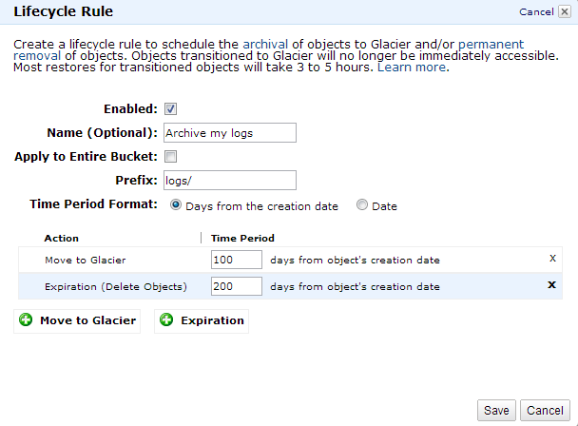


Or send S3 files directly to Glacier
S3
Glacier

Slide 127
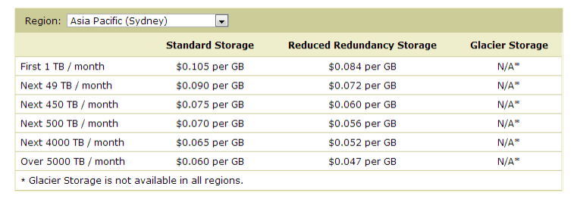
S3 storage costs as low as 4.7 cents per GB

Slide 128
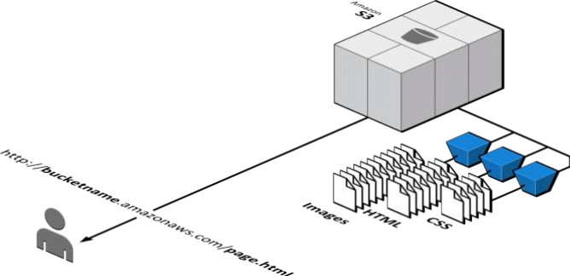
Serve static content at high volumes

Slide 129
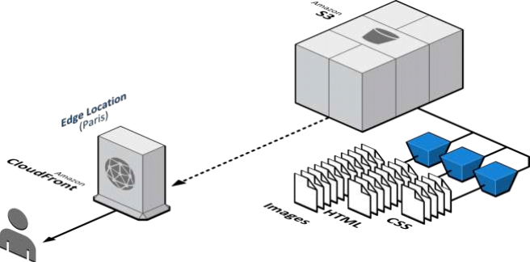
Deliver content with lower latency via Amazon CloudFront

Slide 130
CloudFront
Content Delivery Network

Slide 131
Agenda
Introduction to CDN
CDN Benefits
CloudFront Overview
CloudFront: How It Works
Customer Examples

Slide 132
Introduction
A Content Delivery Network is a network of servers hosted by a service provider in multiple locations of the world so that the content could always be served from a server that is nearest to the consumer requesting for it.
A Content Delivery Network (CDN) consists of two components:
The Origin Server(s) – where the content to be distributed over Internet is originally stored .
Cache Server(s) – where the content is duplicated.

Slide 133
Introduction ..contd
There is generally one Origin Server and many cache servers so that, when a consumer is requesting a particular content on the Internet, it can be served by a cache server nearest to the consumer’s geographical location if the content is available there.
Content Delivery Networks (CDNs) have been proposed to maximize bandwidth, improve accessibility, and maintain correctness through content replication.
With CDNs, content is distributed to cache servers located close to users, resulting in fast, reliable applications and Web services for the users.

Slide 134
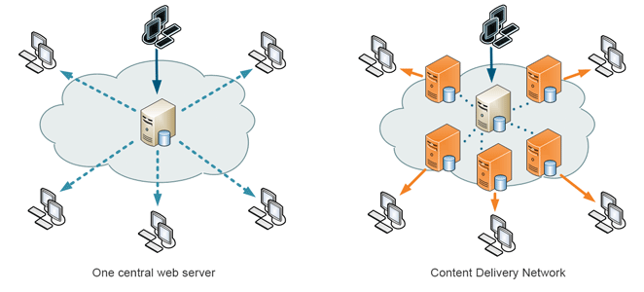
One vs Many
Origin server
Cache servers

Slide 135
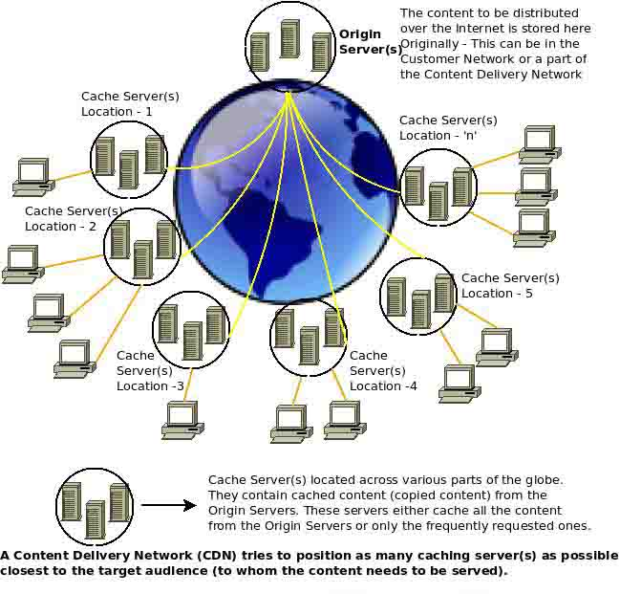
CDN block diagram

Slide 136
CDN Distribution
136
origin server
in North America
Content replication
CDN company installs thousands of servers throughout Internet
In large datacenters
Or, close to users
CDN replicates customers content
When provider updates content, CDN updates servers
CDN distribution node
CDN server
in S. America
CDN server
in Asia
CDN server
in Europe

Slide 137
Advantages
Some of the major advantages of using a CDN are as follows:
Websites load quicker.
Saves a lot of bandwidth — ideal for heavy traffic websites or those with limited shared hosting accounts
Less pressure on hosting server.
CDN’s are highly redundant as requests can always be transferred to other servers (if one of them is down) and hence they almost provide 100% availability.

Slide 138
Technologies used by CDN
While the static content can be cached on the cache servers to be served immediately to the consumers, dynamic content/ embedded objects etc, cannot. So, CDN takes advantage of the http request procedure.
The fastest and the least congested route (between the cache server and the origin server) is estimated continuously, and the traffic is sent in that route.
Some CDN’s can prioritize the Interactive/ multimedia traffic in their networks to improve their performance.
CDN can use Pull or Push technologies, or both. A pull technology requests for content from the origin server on the receipt of a request from consumers, and also saves it in the process. A push technology involves origin server pushing out all content to cache servers before hand.

Slide 139
Where to Use?
Downloading: Large files are best stored on a CDN. This allows users to download files faster and helps reduce the resource load on the site’s server.
Streaming: Streaming audio or video is a very server intensive process and typically uses a CDN to allow server stability. Depending on the provider, content can be streamed. However, it is important to note that not all CDN providers offer audio and video streaming.
Static Files: Smaller files, such as CSS files, graphics and javascript scripts are ideal for a CDN. These allow the load of a website’s server to be reduced by offloading the task to the CDN.

Slide 140








CDN Providers

Slide 141
AWS CloudFront
Web service for content delivery
Distribute content to end users with low latency, high data transfer speeds, and no commitments
Delivers your content using a global network of 50+ edge locations
Supports download, streaming, live streaming, and dynamic content
Key features: RTMP Streaming, HTTPS Delivery, Private Content for HTTP & Streaming, Programmatic Invalidation, Detailed Logs for HTTP & Streaming, Default Root Object
Use Cases: Video and Rich Media, Online Gaming, Interactive Agencies, Software Downloads, Static Websites
Static web content that must be delivered to global user base at Highest bandwidth / Lowest latency / Lowest cost
Notes:
Amazon CloudFront is a web service for content delivery. It integrates with other Amazon Web Services to give developers and businesses an easy way to distribute content to end users with low latency, high data transfer speeds, and no commitments.

Slide 142



Global CloudFront Network
Europe
Amsterdam (2)
North America
Ashburn, VA (3)
Dallas, TX (2)
Hayward, CA
Jacksonville, FL
Los Angeles, CA (2)
Miami, FL
Newark, NJ
New York, NY (3)
Palo Alto, CA
Seattle, WA
San Jose, CA
South Bend, IN
St. Louis, MO
Dublin
Frankfurt (2)
London (2)
Madrid
Milan
Paris (2)
Stockholm
Asia
Chennai
Hong Kong (2)
Mumbai
Osaka
Seoul
Singapore (2)
Tokyo (2)
South America
Sao Paulo
Australia
Sydney

Slide 143



CloudFront Overview
Simple DIY configuration with web console
Simple to Use
No consultants to hire
No proprietary languages to learn
Designed to work with origins in Amazon EC2
AWS Integration
Connections to AWS regions closely monitored
Standard AWS resources (like CloudFormation)
No additional charges or set up fees
Low Cost
Pay only for requests and data transfer

Slide 144




Sites Mix Static and Dynamic Content
Dynamic
Static

Slide 145

Static Content
Static content is the objects
on your website that don’t
change from user to user
• Images
• Media
• CSS
• JavaScript

Slide 146


Features for Delivering Static Objects
• HTTP/HTTPS file delivery
• Private Content with Signed URLs
• Programmatic Invalidation
• Access Logs
• Full Control via APIs

Slide 147
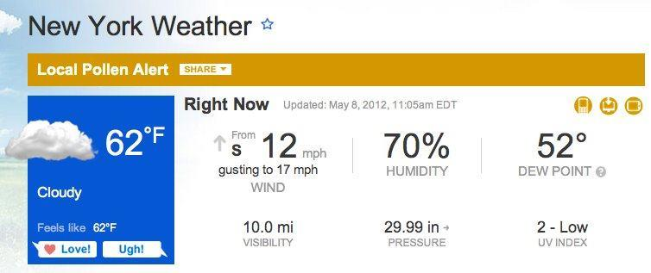



Dynamic Content
Dynamic content is the interactive or personalized portion of a website,
created on-the-fly for each end user
•
News
•
Weather
•
Sports
•
Social Media
•
Advertising
•
Stocks
•
Ecommerce
•
Travel

Slide 148

Features for Dynamic Content
1.
Connection optimizations
2.
Multiple cache behaviors and origin
servers
3.
Query string parameters and cookie
support
4.
Custom SSL Certificates
5.
Zone Apex Support

Slide 149











Typical Website Architecture
Dynamic Content
www.example.com/*.php
OR
Elastic Load
Balancing
Custom Origin
Amazon EC2
Static Content
cdn.example.com/*.jpg
OR
Amazon S3
Custom Origin

Slide 150






Content Delivery with CloudFront
Dynamic Content
OR
Amazon CloudFront
www.example.com
Elastic Load
Balancing
Custom Origin
*.php
Amazon EC2
Static Content
*.jpg
OR
Amazon S3
Custom Origin

Slide 151
CloudFront can make your web applications…….
Faster
Scale Better
More Available
Easier to Manage
Cost Less

Slide 152
Faster: The Performance Problem
Long Distance + Poor Network = Slow Load Times

Slide 153
Faster: How CloudFront Helps
CloudFront helps change this equation to…
Short Distance + Optimized Network = Fast Load Times

Slide 154







Faster: Optimized Network Paths
Dynamic Content
Low Latency
TCP/IP Window Sizing
Amazon CloudFront
www.example.com
*.php
Static Content
*.jpg
Persistent Connections
Monitored Network Paths

Slide 155
CloudFront can make your web applications…….
Faster
Scale Better
More Available
Easier to Manage
Cost Less

Slide 156



Scale Better: How CloudFront Helps
Caching static content at the Edge.
Offloading connection set-up and SSL negotiation to the Edge.
Persistent connections and collapse forwarding help scale your
origin.

Slide 157
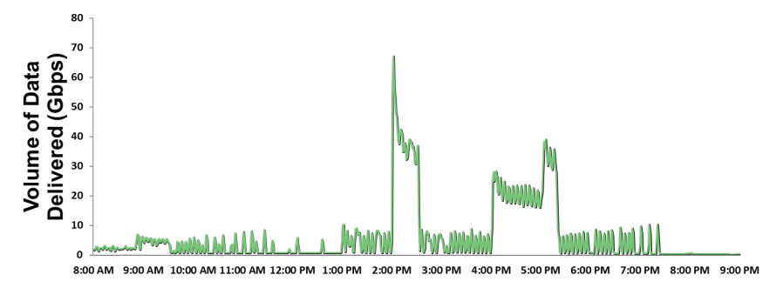
Scalability
Peak usage over 60 Gbps
Example: Video banner ad customer

Slide 158
CloudFront can make your web applications…….
Faster
Scale Better
More Available
Easier to Manage
Cost Less

Slide 159
CloudFront can make your web applications…….
Faster
Scale Better
More Available
Easier to Manage
Cost Less

Slide 160
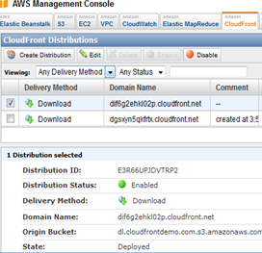
Easy to Configure and Manage
No custom code
Self service signup and configuration
– anytime, from anywhere.
AWS Management Console to
create and manage CloudFront
distributions.
Programmatic APIs for integration
into your own systems and workflow.

Slide 161
CloudFront can make your web applications…….
Faster
Scale Better
More Available
Easier to Manage
Cost Less

Slide 162
Cost Less: How CloudFront Helps
Same price for dynamic and static content!
Preferential pricing on origin fetches from S3 and EC2.
CloudFront is less expensive than AWS Data Transfer, over 10 TB/mth.
Reserved Capacity Pricing for reduced rates with commitment.

Slide 163
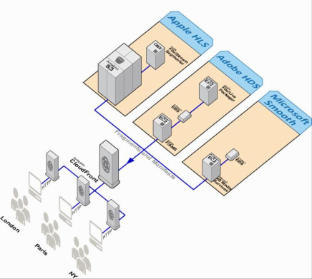
Features for Live and VOD Streaming
Support for all device types
HTTP protocols – Adobe HDS, Apple HLS,
Microsoft Smooth Streaming, MPEG-DASH
RMTP protocol for Flash clients (VOD only)
Simple to configure
Live streaming stack managed through
CloudFormation script
VOD - upload .flv to S3, stream via RTMP
Flexible
Full control over streaming origin enables
freedom to enable and configure supported
features

Slide 164
Amazon Route53
Domain Name System

Slide 165
Agenda
About Route 53
What is DNS Failover?
Architectures enabled
Types of endpoints and how to get failover for each
How do I see health status?
Customer example: multi-region failover scenario
Q& A

Slide 166
Introduction
Route end users to Internet applications
Answers DNS queries with low latency by using a global network of DNS servers
Latency based routing to closest AWS endpoint (e.g. EC2 instances, Elastic IPs or ELBs)
Integration with other AWS services (e.g., ELB)
Notes:
Amazon Route 53 is a highly available and scalable Domain Name System (DNS) web service. It is designed to give developers and businesses an extremely reliable and cost effective way to route end users to Internet applications by translating human readable names like www.example.com into the numeric IP addresses like 192.0.2.1 that computers use to connect to each other. Route 53 effectively connects user requests to infrastructure running in Amazon Web Services (AWS) – such as an Amazon Elastic Compute Cloud (Amazon EC2) instance, an Amazon Elastic Load Balancer, or an Amazon Simple Storage Service (Amazon S3) bucket – and can also be used to route users to infrastructure outside of AWS.
Latency and Weighted round robin routing (“DNS load balancing)”
Amazon Route 53 is designed to propagate updates you make to your DNS records to its world-wide network of authoritative DNS servers within 60 seconds under normal conditions.

Slide 167



How it works?
Where is
www.example.com?
I don’t know – I’ll
ask the authority
53
Users
DNS Resolver
Route 53
192.0.2.1
192.0.2.1

Slide 168


What is DNS Failover?
+
Health checks
Failover
Automated requests sent over
the Internet to your application
to verify that your application is
reachable, available, and
functional
Only return answers for resources
that are healthy and reachable
from the outside world, so that
your end users are routed away
from a failed or unhealthy part of
your application

Slide 169
What is DNS Failover?
Improve availability of your applications running on AWS
So that you can configure backup and failover scenarios for your own applications
Enable highly available multi-region architecture on AWS
Providing a means to failover across regions

Slide 170
DNS Failover: A Glossary
Endpoint: an Internet location, defined as an IP address, URL, or ELB name, that is checked periodically to determine whether a healthy response is returned.
This represents an ELB, and EC2 instance, or an arbitrary IP Address
Health Check: This is what your create in the Route 53 console or API.
Has a status of either healthy or unhealthy depending on the results of our probing endpoint
You can associate one or more DNS records with the health check

Slide 171
How Does it Work?
Route 53 conducts health checks from within each AWS region
To perform a health check, Route 53 makes a request to the specified IP address / URL. If we get a successful response, the health check passes. If not, the health check fails.
If a health check fails, all DNS records that are dependent on the health check will be made inactive; DNS records that have been configured as backups will become active
Total time from endpoint failure to DNS failover is about 3 minutes

Slide 172
Amazon VPC
Virtual Private Cloud

Slide 173
VPC
Amazon Virtual Private Cloud (VPC)
Secure and seamless bridge between a company’s existing private network and the AWS cloud
Connect existing infrastructure to a set of isolated AWS compute resources via a Virtual Private Network (VPN) connection
Bring your own address space and extend existing management capabilities
Notes:
Amazon Virtual Private Cloud (Amazon VPC) lets you provision a private, isolated section of the Amazon Web Services (AWS) Cloud where you can launch AWS resources in a virtual network that you define. With Amazon VPC, you can define a virtual network topology that closely resembles a traditional network that you might operate in your own datacenter. You have complete control over your virtual networking environment, including selection of your own IP address range, creation of subnets, and configuration of route tables and network gateways.

Slide 174
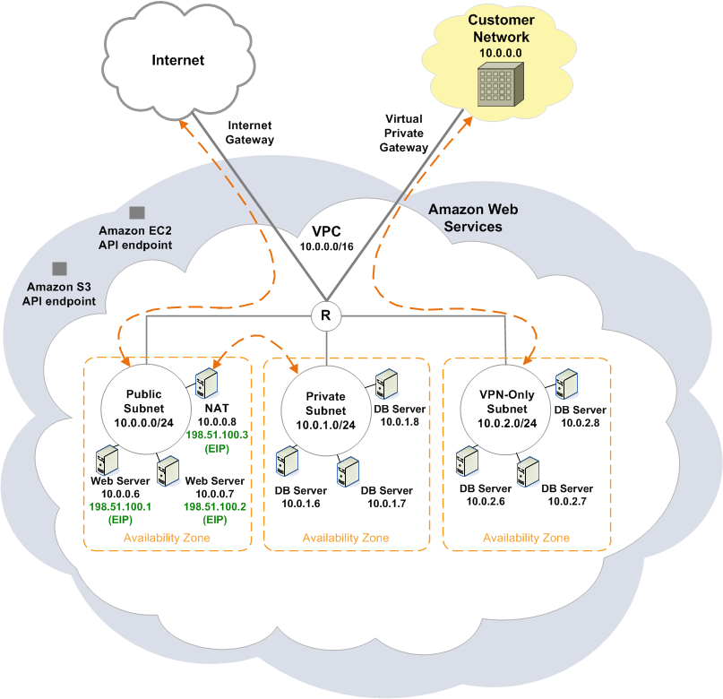
Notes:
Amazon Virtual Private Cloud (Amazon VPC) lets you provision a private, isolated section of the Amazon Web Services (AWS) Cloud where you can launch AWS resources in a virtual network that you define. With Amazon VPC, you can define a virtual network topology that closely resembles a traditional network that you might operate in your own datacenter. You have complete control over your virtual networking environment, including selection of your own IP address range, creation of subnets, and configuration of route tables and network gateways.

Slide 175
EC2 Classic
Internet
23.20.103.11
23.20.148.59
72.44.21.7
72.43.2.17
23.19.11.5
72.18.7.3
EC2
EC2
EC2
EC2
Customer 1
EC2
10.8.56.23
10.16.22.33
10.218.2.35
EC2
Customer 2
EC2
EC2
EC2
10.1.2.3
10.27.45.16
10.27.45.16
AZ A
AZ B
Customer 3
AWS Region – EC2 classic is one big 10.0.0.0/8 network

Slide 176
VPC
Internet
Internet GW
EC2
EC2
EC2
EC2
10.0.1.11
10.0.1.12
10.0.2.11
10.0.2.12
(23.20.103.11)
(72.44.21.7)
SN 10.0.1.0/24
SN 10.0.2.0/24
VPC 10.0.0.0/16
AZ A
AZ B
AWS Region – VPC network isolation

Slide 177
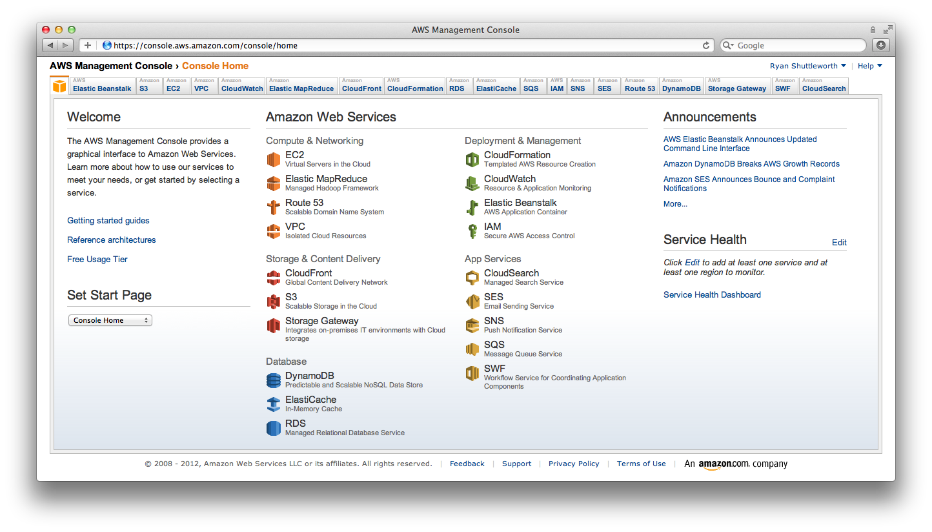
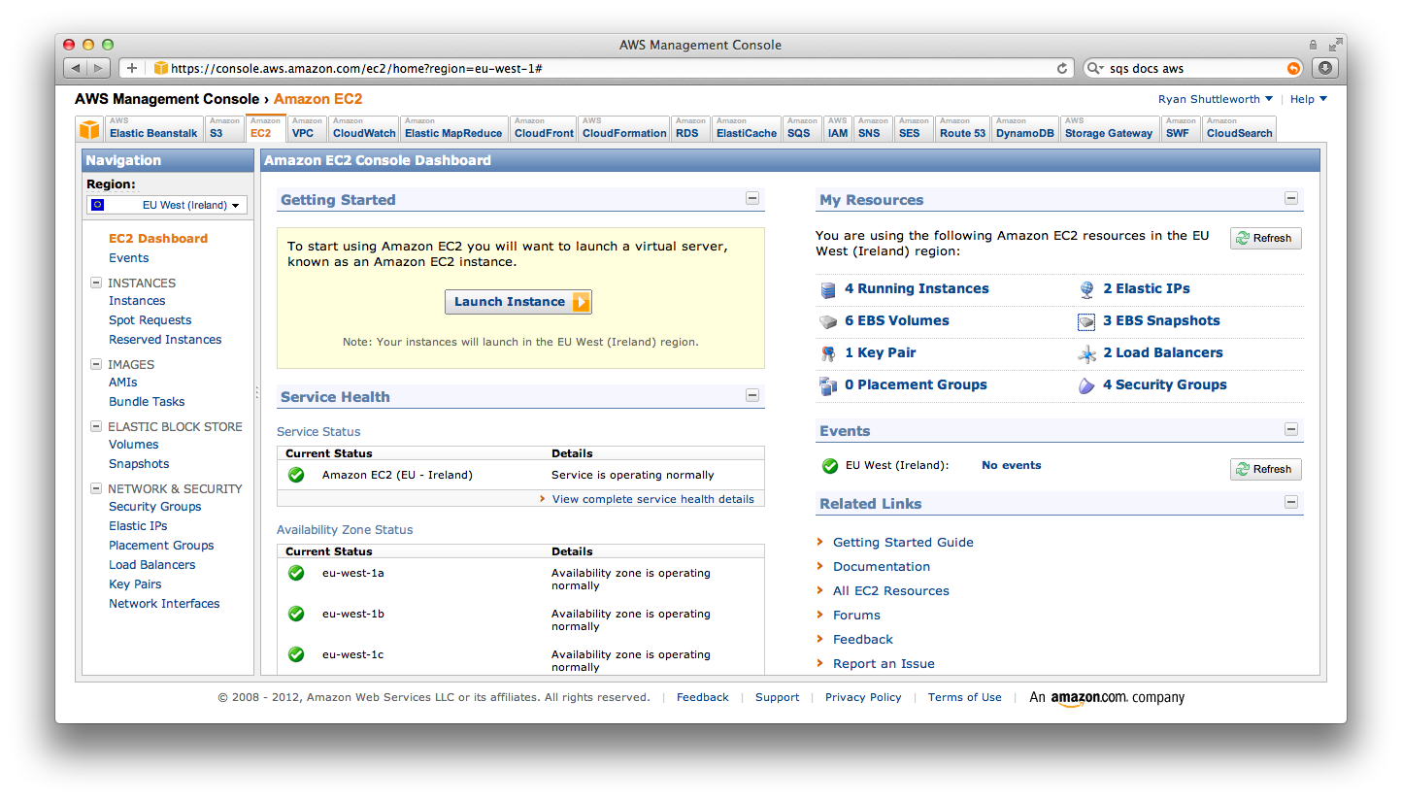
Web Console
On-demand, Self Service Management Access
Notes:
The AWS Management Console provides a point-and-click web interface for Amazon Web Services. Log in using your AWS account name and password. If you’ve enabled AWS Multi-Factor Authentication, you will be prompted for your device’s authentication code.

Slide 178
CLIs, Libraries, & SDKs
Your choice of programming language (Java, PHP, Python, Ruby, .NET) and mobile platform (Android, iOS)
The Developer Centers contains sample code, documentation, tools, and additional resources to help you build applications on Amazon Web Services.
http://aws.amazon.com/java/
http://aws.amazon.com/mobile/
http://aws.amazon.com/php/
http://aws.amazon.com/python/
http://aws.amazon.com/ruby/
http://aws.amazon.com/net/
New! Universal CLI based on Python!

Slide 179
Deployment and Management
AWS Elastic Beanstalk
Simply upload your application (Java, NET, PHP, Ruby, and Python)
Automatically handles the deployment details of capacity provisioning, load balancing, auto-scaling, and application health monitoring
Retain full control over the AWS resources powering your application
Notes:
Talking Points
Quickly deploy Java, NET or PHP web app to AWS cloud
Simply upload the file
Stores in S3
Creates EC2 instance w/ Tomcat 6 or 7 and deploys app
CloudWatch alarms and Autoscaling
SNS to track progress and events
After stack creation, you have full control of environment
SSH into instance
Change AutoScaling parameters
Narrative
“Easy to begin, Impossible to outgrow”
AWS Elastic Beanstalk is an even easier way for you to quickly deploy and manage applications in the AWS cloud. You simply upload your application, and Elastic Beanstalk automatically handles the deployment details of capacity provisioning, load balancing, auto-scaling, and application health monitoring. At the same time, with Elastic Beanstalk, you retain full control over the AWS resources powering your application and can access the underlying resources at any time. Elastic Beanstalk leverages AWS services such as Amazon EC2, Amazon S3, Amazon Simple Notification Service, Elastic Load Balancing, and Auto-Scaling to deliver the same highly reliable, scalable, and cost-effective infrastructure that hundreds of thousands of businesses depend on today. AWS Elastic Beanstalk is easy to begin and impossible to outgrow.
Most existing application containers or platform-as-a-service solutions, while reducing the amount of programming required, significantly diminish developers' flexibility and control. Developers are forced to live with all the decisions pre-determined by the vendor - with little to no opportunity to take back control over various parts of their application's infrastructure. However, with Elastic Beanstalk, you retain full control over the AWS resources powering your application. If you decide you want to take over some (or all) of the elements of their infrastructure, you can do so seamlessly by using Elastic Beanstalk's management capabilities.
The first release of Elastic Beanstalk is built for Java developers using the familiar Apache Tomcat (6 or 7) software stack which ensures easy portability for your application. There is no additional charge for Elastic Beanstalk - you only pay for the AWS resources needed to store and run your applications.
Supports Tomcat 6 and 7 containers
Quirkus by Coucho – interprets PHP and bundles
PHP Fog and Cloud…

Slide 180
Deployment and Management
AWS CloudFormation
Create templates of stack of resources
Deploy stack from template with runtime parameters
Templates are simple JSON formatted text files
CloudFormer supports generating templates from running environments
"Resources" : {
"Ec2Instance" : {
"Type" : "AWS::EC2::Instance",
"Properties" : {
"SecurityGroups" : [ { "Ref" : "InstanceSecurityGroup" } ],
"ImageId" : { "Fn::FindInMap" : [ "RegionMap", { "Ref" : "AWS::Region" }, "AMI" ]},
"Tags" : [{
"Key" : "MyTag",
"Value" : "TagValue"
}]
}
},
Notes:
Talking Points
Template language (JSON)
Define resources (e.g., EC2 w/ EBS vols, S3 buckets, SimpleDB domains)
Define input/runtime parameters (e.g.. # instances, name of war file to deploy)
Resources provisioned in correct order: CloudFormation calculates dependency tree
Very powerful way to create stacks for Dev, Test, Stage, etc.
Narrative
AWS CloudFormation gives developers and systems administrators an easy way to create a collection of related AWS resources and provision them in an orderly and predictable fashion.
Developers can use AWS CloudFormation’s sample templates or create their own templates to describe the AWS resources, and any associated dependencies or runtime parameters, required to run their application. You don’t need to figure out the order in which AWS services need to be provisioned or the subtleties of how to make those dependencies work. CloudFormation takes care of this for you.
Different approaches…baking AMIs vs. bootstrapping – trade offs
Dev Ops course coming in a few months…and that gets into details – 1 day dedicated to config mgmt

Slide 181

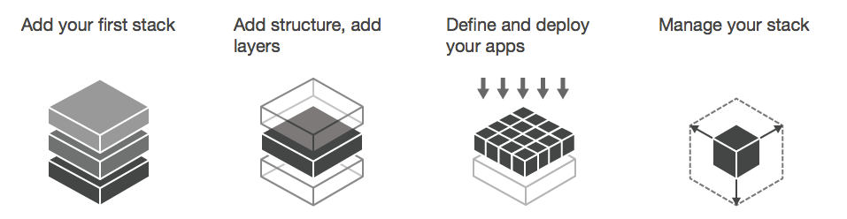
Deployment and Management
AWS OpsWorks
Model the layers of your applications into stacks
Use Chef recipes and cookbooks
Prebuilt templates for PHP, Ruby, Java, Node.js
Granular security control
Notes:
Talking Points
Template language (JSON)
Define resources (e.g., EC2 w/ EBS vols, S3 buckets, SimpleDB domains)
Define input/runtime parameters (e.g.. # instances, name of war file to deploy)
Resources provisioned in correct order: CloudFormation calculates dependency tree
Very powerful way to create stacks for Dev, Test, Stage, etc.
Narrative
AWS CloudFormation gives developers and systems administrators an easy way to create a collection of related AWS resources and provision them in an orderly and predictable fashion.
Developers can use AWS CloudFormation’s sample templates or create their own templates to describe the AWS resources, and any associated dependencies or runtime parameters, required to run their application. You don’t need to figure out the order in which AWS services need to be provisioned or the subtleties of how to make those dependencies work. CloudFormation takes care of this for you.
Different approaches…baking AMIs vs. bootstrapping – trade offs
Dev Ops course coming in a few months…and that gets into details – 1 day dedicated to config mgmt

Slide 182
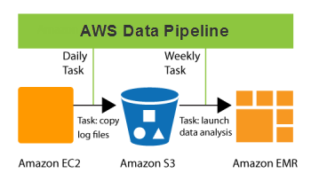
Data Pipeline
Amazon Data Pipeline
Automates the movement and processing of data using data-driven workflows and built-in dependency checking
A Pipeline Definition is composed of the following:
Data Sources
Preconditions
Destinations
Processing Steps
An Operational Schedule
Notes:
Amazon CloudWatch provides monitoring for AWS cloud resources and the applications customers run on AWS. Developers and system administrators can use it to collect and track metrics, gain insight, and react immediately to keep their applications and businesses running smoothly. Amazon CloudWatch monitors AWS resources such as Amazon EC2 and Amazon RDS DB instances, and can also monitor custom metrics generated by a customer’s applications and services. With Amazon CloudWatch, you gain system-wide visibility into resource utilization, application performance, and operational health.

Slide 183
Deployment and Management
Amazon CloudWatch
Visibility into resource utilization, operational performance, and overall demand patterns
Metrics such as CPU utilization, disk reads and writes, and network traffic
Accessible via the AWS Management Console, web service APIs or Command Line Tools
Add custom metrics of your own
Alarms (which tie into auto-scaling, SNS, SQS, etc.)
Billing Alerts to help manage charges on AWS bill
Notes:
Amazon CloudWatch provides monitoring for AWS cloud resources and the applications customers run on AWS. Developers and system administrators can use it to collect and track metrics, gain insight, and react immediately to keep their applications and businesses running smoothly. Amazon CloudWatch monitors AWS resources such as Amazon EC2 and Amazon RDS DB instances, and can also monitor custom metrics generated by a customer’s applications and services. With Amazon CloudWatch, you gain system-wide visibility into resource utilization, application performance, and operational health.

Slide 184
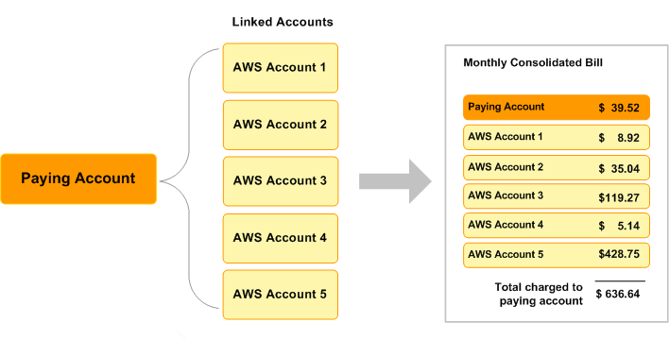
Consolidated Billing
Allows you to get one bill for multiple accounts
You can easily track each account's costs and download the cost data in CSV format
You may be able to reduce costs by combining usage from all the accounts to qualify for volume pricing discounts
Notes:
Consolidated Billing enables you to see a combined view of AWS costs incurred by all accounts in your department or company, as well as obtain a detailed cost report for each individual AWS account associated with your paying account. Consolidated Billing may also lower your overall costs since the rolled up usage across all of your accounts could help you reach lower-priced volume tiers more quickly. http://docs.amazonwebservices.com/AWSConsolidatedBilling/1.0/AWSConsolidatedBillingGuide.html

Slide 185

Putting Foundation Services Together

Slide 186
deployment model: availability

Slide 187
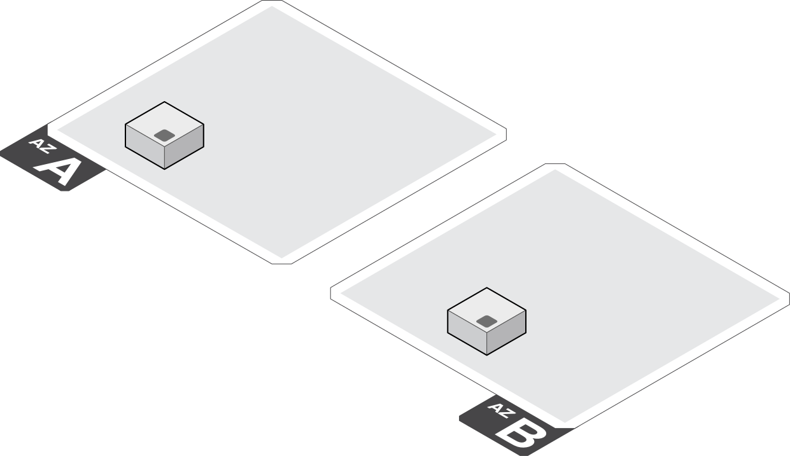
Use multiple availability zones

Slide 188
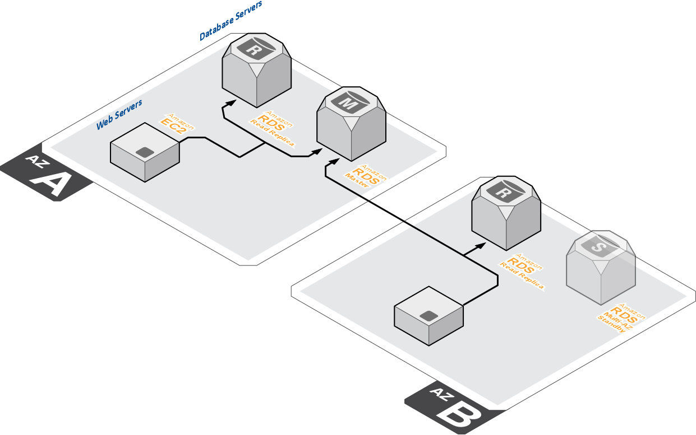
Use RDS with replicas and standby

Slide 189
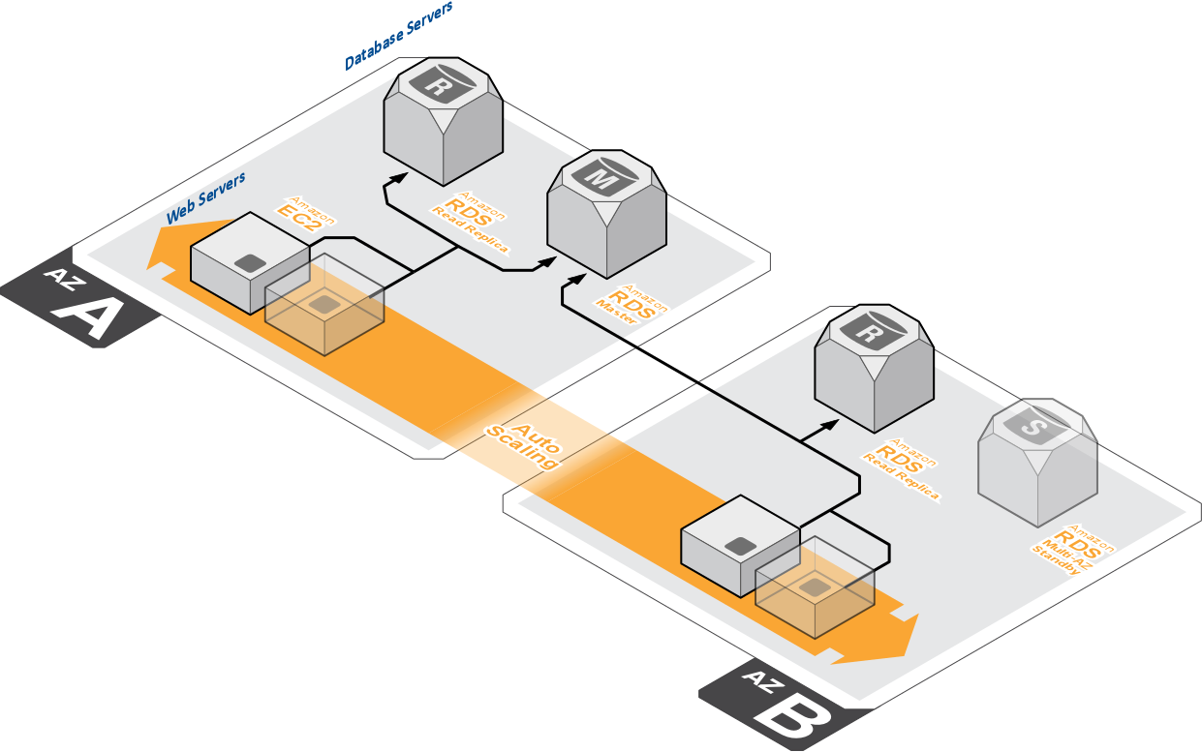
Use auto-scaling groups

Slide 190
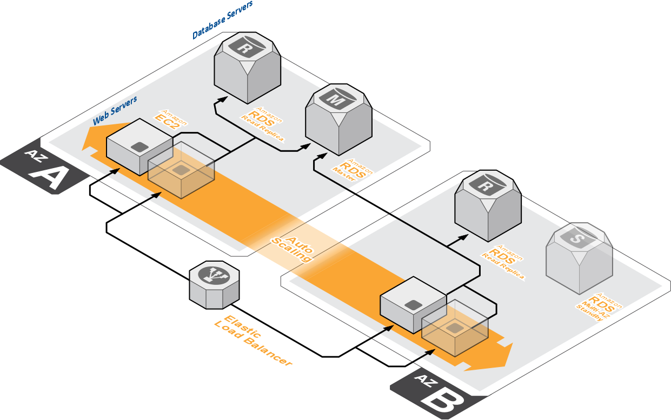
Use Elastic Load Balancing

Slide 191
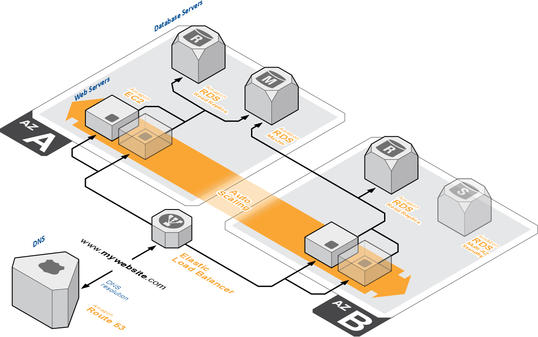
Use Route53 to host DNS zones

Slide 192
Three Services: Better Together
Metrics
Utilization
Latency
CloudWatch
Auto Scaling
Elastic Load Balancer

Slide 193
Architect to use cloud strengths
Elastic Load Balancing
Route 53
RDS
Auto-scaling
Use at regional level
Combined with autoscaling will balance requests and resource capacity across availability zones
Within VPC
Use to loadbalance between application tiers within an availability zone
Instance migrations
Easily move instances from dev environments to test environments by moving between ELBs
Leverage SLA
Improve application reliability with Route 53’s SLA on requests served
Weighted routing
Perform A/B analysis, and staged application roll-outs by moving a portion of traffic to new infrastructure
Control TTLs and updates
Take absolute control of DNS updates for more decisive system updates
Scale databases without admin overhead
Choose instance size for databases and scale up over time
Add high availability from management console
Create master-slave configurations and read-replicas. AWS takes care of the failover and recreation of a new slave in event of master DB loss
Dynamically scale resources & control costs
Only provision the resources that are required with scale up and cool down policies that match demand

Slide 194
Services not software
+
Use AWS services
Your technology skills
=
Less time managing and installing software
More time focused on mission applications
let AWS do the heavy lifting

Slide 195
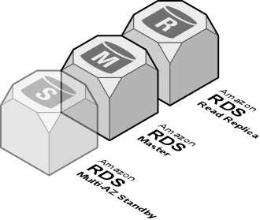
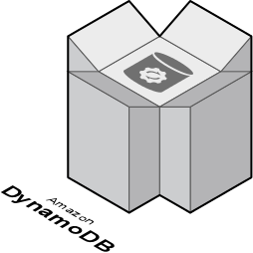
Services not software
Use RDS for databases
Relational Database Service
Database-as-a-Service
No need to install or manage database instances
Scalable and fault tolerant configurations
DynamoDB
Provisioned throughput NoSQL database
Fast, predictable performance
Fully distributed, fault tolerant architecture
Use DynamoDB for high performance key-value DB

Slide 196
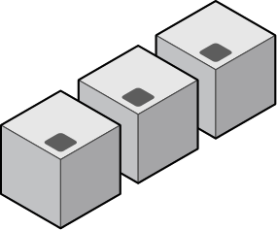


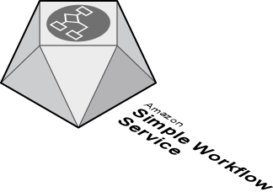

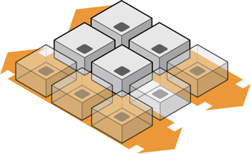
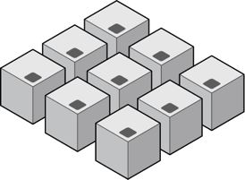
Services not software
Processing results
Amazon SQS
Reliable, highly scalable, queue service for storing messages as they travel between instances
Reliable message queuing without additional software
Amazon SQS
Processing task/processing trigger
1
Simple Workflow
Reliably coordinate processing steps across applications
Integrate AWS and non-AWS resources
Manage distributed state in complex systems
2
Push inter-process workflows into the cloud with SWF
Task A
Task B
(Auto-scaling)
3
Task C

Slide 197
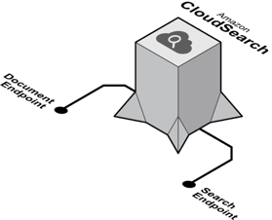


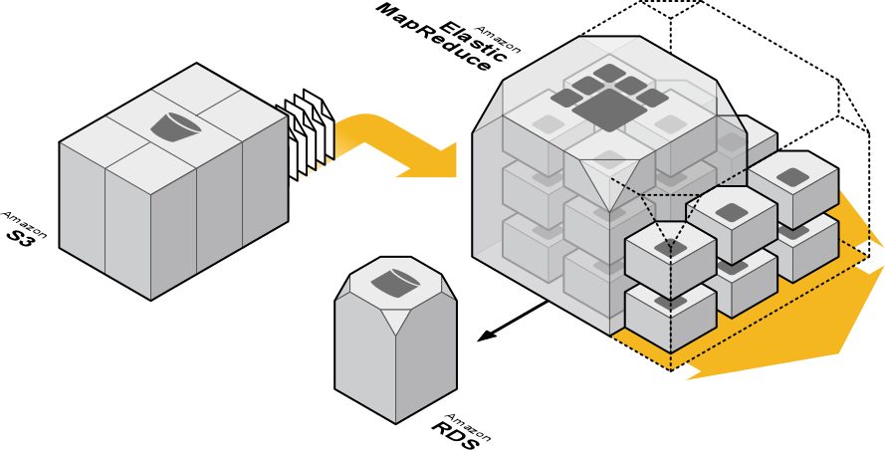
Services not software
Cloud Search
Elastic search engine based upon Amazon A9 search engine
Fully managed service with sophisticated feature set
Scales automatically
Document
Server
Don’t install search software, use CloudSearch
Search
Server
Results
Elastic MapReduce
Elastic Hadoop cluster
Integrates with S3 & DynamoDB
Leverage Hive & Pig analytics scripts
Integrates with instance types such as spot
Process large volumes of data cost effectively with EMR

Slide 198
SECURITY IS A SHARED
RESPONSIBLITY
Notes:
So in 2006 Amazon Web Services was born. It's mission was clear: to enable businesses and developers to use web services to scalable sophisticated applications. It's interesting to note that what we called Web Services, has now morphed into a common term 'the Cloud'. Amazon Web Services is and always has been a distinct and individual Amazon organization.

Slide 199
Customer Data
Customers implement their own set of controls
Multiple customers with FISMA Low and Moderate ATOs
Platform, Applications, Identity & Access Management
Customer
Operating System, Network & Firewall Configuration
Client-side Data Encryption & Data Integrity Authentication
Server-side Encryption
(File System and/or Data)
Network Traffic Protection
(Encryption/Integrity/Identity)
Foundation Services
SAS-70 Type II
ISO 27001/ 2 Certification
Payment Card Industry (PCI)
Data Security Standard (DSS)
NIST Compliant Controls
DoD Compliant Controls
FedRAMP Compliant Controls
HIPAA and ITAR Compliant
Compute
Storage
Database
Networking
Amazon
AWS Global Infrastructure
Availability Zones
Edge Locations
Regions
Notes:
Since AWS and its customers share control over the IT environment, both parties have responsibility for managing the IT environment. AWS’ part in this shared responsibility includes providing its services on a highly secure and controlled platform and providing a wide array of security features customers can use. The customers’ responsibility includes configuring their IT environments in a secure and controlled manner for their purposes. While customers don’t communicate their use and configurations to AWS, AWS does communicate its security and control environment relevant to customers. AWS does this by doing the following:
• Obtaining industry certifications and independent third party attestations described in this document
• Publishing information about the AWS security and control practices in whitepapers and web site content
• Providing certificates, reports, and other documentation directly to AWS customers under NDA (as required)

Slide 200

Physical Security of Data Centers
Amazon has been building large-scale data centers for many years
Important attributes:
Non-descript facilities
Robust perimeter controls
Strictly controlled physical access
2 or more levels of two-factor auth
Controlled, need-based access
All access is logged and reviewed
Separation of Duties
employees with physical access don’t have logical privileges
Notes:
Physical Security
Amazon has many years of experience in designing, constructing, and operating large-scale datacenters. This experience has been applied to the AWS platform and infrastructure. AWS datacenters are housed in nondescript facilities. Physical access is strictly controlled both at the perimeter and at building ingress points by professional security staff utilizing video surveillance, intrusion detection systems, and other electronic means. Authorized staff must pass two-factor authentication a minimum of two times to access datacenter floors. All visitors and contractors are required to present identification and are signed in and continually escorted by authorized staff.
AWS only provides datacenter access and information to employees and contractors who have a legitimate business need for such privileges. When an employee no longer has a business need for these privileges, his or her access is immediately revoked, even if they continue to be an employee of Amazon or Amazon Web Services. All physical access to datacenters by AWS employees is logged and audited routinely.

Slide 201


EC2 Security
Host operating system
Individual SSH keyed logins via bastion host for AWS admins
All accesses logged and audited
Guest (a.k.a. Instance) operating system
Customer controlled (customer owns root/admin/keypairs)
AWS admins cannot log in
Stateful firewall
Mandatory inbound firewall, default deny mode
Customer controls configuration via Security Groups
Signed API calls
Require X.509 certificate or customer’s secret AWS key
Storage Security
Disks wiped upon Volume creation
All block storage supports user-implemented encryption
All storage devices are securely decommissioned.
Notes:
Amazon Elastic Compute Cloud (Amazon EC2) Security
Security within Amazon EC2 is provided on multiple levels: the operating system (OS) of the host system, the virtual instance operating system or guest OS, a firewall, and signed API calls. Each of these items builds on the capabilities of the others. The goal is to protect against data contained within Amazon EC2 from being intercepted by unauthorized systems or users and to provide Amazon EC2 instances themselves that are as secure as possible without sacrificing the flexibility in configuration that customers demand.
Multiple Levels of Security
Host Operating System: Administrators with a business need to access the management plane are required to use multi-factor authentication to gain access to purpose-built administration hosts. These administrative hosts are systems that are specifically designed, built, configured, and hardened to protect the management plane of the cloud. All such access is logged and audited. When an employee no longer has a business need to access the management plane, the privileges and access to these hosts and relevant systems are revoked.
Guest Operating System: Virtual instances are completely controlled by the customer. Customers have full root access or administrative control over accounts, services, and applications. AWS does not have any access rights to customer instances and cannot log into the guest OS. AWS recommends a base set of security best practices to include disabling password-only access to their hosts, and utilizing some form of multi-factor authentication to gain access to their instances (or at a minimum certificate-based SSH Version 2 access). Additionally, customers should employ a privilege escalation mechanism with logging on a per-user basis. For example, if the guest OS is Linux, after hardening their instance, they should utilize certificate-based SSHv2 to access the virtual instance, disable remote root login, use command-line logging, and use ‘sudo’ for privilege escalation. Customers should generate their own key pairs in order to guarantee that they are unique, and not shared with other customers or with AWS.
Firewall: Amazon EC2 provides a complete firewall solution; this mandatory inbound firewall is configured in a default deny-all mode and Amazon EC2 customers must explicitly open the ports needed to allow inbound traffic. The traffic may be restricted by protocol, by service port, as well as by source IP address (individual IP or Classless Inter-Domain Routing (CIDR) block).
Storage:
All of the storage devices that are used in AWS datacenters are securely decommissioned using techniques from DoD 5220.22-M (“National Industrial Security Program Operating Manual “) and NIST 800-88 (“Guidelines for Media Sanitization”), ultimately resulting in degaussing and physical destruction.

Slide 202












Architected for Security Requirements
Certifications and accreditations for workloads that matter
AWS CloudTrail - AWS API call logging for governance & compliance
Log and review user activity
Stores data in S3, or archive to Glacier
Notes:
The best solution is to validate cloud provider security is to get accredited experts to do it for you.
Auditors are constantly moving through the AWS environment. There is seldom a day when professional 3rd party auditors are not engaging deeply with AWS physical and logical security controls; testing, validating, finding ways to improve security, documenting all that, and generating the rich body of evidence that backs up.
Cloud Service Provider auditors understand cloud in general, they understand where AWS plays in the cloud landscape, they understand risk, and they understand the customer use cases in depth. They interpret the traditional standards for you, applying them to AWS in a way that makes sense. They can do a much better job than most audit functions at companies with limited experience in doing this specifically.
Multiple certifications and reports offered by AWS provides the ability for customers to triangulate on risk and controls if there isn't a report that meets their exact needs. With one report or certification, it's a great set of data, but with multiple (overlapping but subtly different controls, different audit types and periods, different points in time), you can get the visibility you need.
As of today, AWS infrastructure has been audited to meet controls for workloads requiring
HIPAA
SOC 1/SSAE 16/ISAE 3402 (formerly SAS70)
SOC 2
SOC 3
PCI DSS Level 1
ISO 27001 FedRAMP(SM)
DIACAP
FISMA
ITAR
FIPS 140-2
CSA
MPAA
But we can’t stop there…

Slide 203
AWS IAM
Identity and Access Management

Slide 204
Agenda
Overview of AWS Identity and Access Management
How to enforce security policies in the cloud
How to integrate with existing directories
Highlight new features along the way

Slide 205

IAM
IAM enables customers to create and manage users in AWS’s identity system
Identity Federation with local directory is an option for enterprises
Very familiar security model
Users, groups, permissions
Allows customers to
Create users
Assign individual passwords, access keys, multi-factor authentication devices
Grant fine-grained permissions
Optionally grant them access to the AWS Console
Organize users in groups
Notes:
AWS Identity and Access Management (IAM) enables you to securely control access to AWS services and resources for your users. IAM enables you to create and manage users in AWS, and it also enables you to grant access to AWS resources for users managed outside of AWS in your corporate directory. IAM offers greater security, flexibility, and control when using AWS.
IAM enables identity federation between your corporate directory and AWS services. This enables you to use your existing corporate identities to grant secure and direct access to AWS resources, such as Amazon S3 buckets, without creating a new AWS identity for those users. To learn more about configuring identity federation with your corporate directory, try out our sample application.

Slide 206
Identity and Access Management
Who?
What Actions?
Which Resources?
When?
Where?
How?

Slide 207
What is AWS Identity and Access
Management?

Slide 208

AWS Identity and Access Management
Access control
for AWS services and resources
that is flexible, powerful, familiar, and secure

Slide 209

IAM

Slide 210


Slide 211

IAM
• Users, groups, permissions
– Individual security credentials
– Secure by default
– Grant least privilege
• Easy to use
– Graphical user interface
– Ability to script/automate (CLI & API)

Slide 212
IAM
Control
• AWS multi-factor authentication
– Hardware tokens
– Smartphone app tokens
• Credential management policies
• Control billing, support, and AWS Marketplace
purchases

Slide 213







Flexible Control That Adapts with Your Needs
Developer
Organizations
Enterprise
No additional charge

Slide 214





















Cloud Resources
Cloud Services
Amazon
RDS
Amazon
SES
Amazon
Route 53
Amazon
CloudWatch
Amazon
SNS
Amazon
DynamoDB
AWS IAM
AWS
OpsWorks
AWS
Storage
Gateway
Amazon Redshift
Amazon
EC2
Amazon
S3
AWS
CloudFormation
Amazon
CloudFront
Amazon
Elastic
MapReduce
Amazon
ElastiCache
Amazon
CloudSearch
Amazon
VPC
Amazon
Simple
Workflow
Amazon Elastic
Transcoder
AWS
Elastic
Beanstalk
Amazon
SQS

Slide 215
Use cases
Ben can terminate instance i-abcd1234 but not instance i-cda12345
Jeff can launch the instances only in subnet subnet-nsbd1234
Ken can use only AMI ami-fedr3214 to run instances
A user can take any action if the resource has a tag “sandbox=${aws.username}”
Derek must authenticate using MFA before he can terminate instances with the tag “stack=prod”

Slide 216
Delegation
Entity that defines a set of permissions
Not associated with a specific user or group
Role must be assumed by trusted entities

Slide 217
IAM Roles for Amazon EC2
Allow Amazon EC2 based apps to act on behalf of another entity
Create a role, apply a policy and launch the instance with role
Credentials are automatically
made available to Amazon EC2 instances
Rotated multiple times a day
AWS SDKs transparently use the credentials

Slide 218






















Roles for EC2 Instances
Auto
Scaling
Auto
Scaling
AWS IAM
Role: RW access
to files, rows
Amazon
DynamoDB
Amazon
S3

Slide 219
IAM Roles for Amazon EC2 - Advantages
Eliminates use of long term credentials
Automatic credential rotation
Less coding – AWS SDK does all the work
Easier and more secure

Slide 220
Familiar → Administration

Slide 222


Slide 223
IAM Policy Simulator
• Test the effect of access control policies before
pushing to production
• Verify and troubleshoot permissions

Slide 224


Slide 225


Slide 226


Slide 227


Slide 228


Slide 229


Slide 230
AWS Command Line Utilities

Slide 231
Examples
aws ec2 describe-instances
aws ec2 run-instances --image-id ami-c481fad3 --instance-type t2.micro --subnet-id subnet-11548a3b --security-group-ids sg-15f8d06e --key-name clidemo
aws iam attach-user-policy --user-name john --policy-arn arn:aws:iam::aws:policy/AmazonS3FullAccess
aws iam list-policies

Slide 232
Introduction
Bulk and transactional email-sending service
Eliminates the hassle of email server management, network configuration, and meeting rigorous Internet Service Provider (ISP) standards
Provides a built-in feedback loop, which includes notifications of bounce backs, failed and successful delivery attempts, and spam complaints
Notes:
Amazon Simple Email Service (Amazon SES) is a highly scalable and cost-effective bulk and transactional email-sending service for businesses and developers. Amazon SES eliminates the complexity and expense of building an in-house email solution or licensing, installing, and operating a third-party email service. The service integrates with other AWS services, making it easy to send emails from applications being hosted on services such as Amazon EC2. With Amazon SES there is no long-term commitment, minimum spend or negotiation required

Slide 233
Database
DynamoDB
ElastiCache
RDS
SimpleDB
RDS
Redshift
Notes:
No Notes

Slide 234
Database
DynamoDB
Fully managed NoSQL database.
Eliminates the administrative burden of data modeling, index maintenance, and performance tuning.
Durability and high-availability - stores data on Solid State Drives (SSDs) and replicates it synchronously across multiple AWS Availability Zones in an AWS Region.
Scalability - With AWS Console, you can grow your DynamoDB table from 10 to 100,000 writes per sec.
See video: http://www.youtube.com/watch?v=oz-7wJJ9HZ0
Notes:
Amazon DynamoDB is a fully managed NoSQL database service that provides fast and predictable performance with seamless scalability. With a few clicks in the AWS Management Console, customers can launch a new Amazon DynamoDB database table, scale up or down their request capacity for the table without downtime or performance degradation, and gain visibility into resource utilization and performance metrics. Amazon DynamoDB enables customers to offload the administrative burdens of operating and scaling distributed databases to AWS, so they don’t have to worry about hardware provisioning, setup and configuration, replication, software patching, or cluster scaling.

Slide 235
Database
Amazon Relational Database Service (RDS)
RDS
Fully-managed, tuned MySQL, Oracle 11g, PostgreSQL, or MS SQL databases
Cost-efficient and resizable capacity
Manages time-consuming database admin tasks
Code, applications, and tools you already use today work seamlessly
Automatically patches the database software and backs up your database
Flexible Licensing: BYOL or License Include
Notes:
Talking Points
Hosted and managed MySQL or Oracle or MS SQL
Manages time-consuming database admin tasks
Backups/snapshots
Upgrades
Replication
Code/apps/tools integrate seamlessly: just change connection string
Multi-AZ and Read-Replica options for MySQL
Narrative
Amazon RDS is a web service that makes it easy to set up, operate, and scale a relational database in the cloud. It provides cost-efficient and resizable capacity while managing time-consuming database administration tasks, freeing you up to focus on your applications and business. Amazon RDS gives you access to the full capabilities of a familiar MySQL database. This means the code, applications, and tools you already use today with your existing MySQL databases work seamlessly with Amazon RDS. Amazon RDS automatically patches the database software and backs up your database, storing the backups for a user-defined retention period. You also benefit from the flexibility of being able to scale the compute resources or storage capacity associated with your relational database instance via a single API call.

Slide 236
Database
Amazon ElastiCache
Fully-managed, distributed, in-memory cache
Memcached or Redis compliant cache cluster on-demand
Manages patching, cache node failure detection and recovery
Simple APIs calls to grow and shrink the cache cluster
Seamlessly caches in front of SimpleDB or RDS instances
Integrated with CloudWatch and SNS for monitoring and alerts
Notes:
Amazon ElastiCache is a web service that makes it easy to deploy, operate, and scale an in-memory cache in the cloud. The service improves the performance of web applications by allowing you to retrieve information from a fast, managed, in-memory caching system, instead of relying entirely on slower disk-based databases. Amazon ElastiCache is protocol-compliant with Memcached, a widely adopted memory object caching system, so code, applications, and popular tools that you use today with existing Memcached environments will work seamlessly with the service.

Slide 237
Database
Amazon SimpleDB
Core database functions of data indexing and querying of text data
No schema, automatic indexing
Eliminates the administrative burden of data modeling, index maintenance, and performance tuning
Real-time lookup and simple querying of structured data
Use cases:
Metadata storage -- often used in conjunction with S3
Structured, fine-grained data needing query
Data needing flexible schema
Notes:
Amazon SimpleDB is a highly available and flexible non-relational data store that offloads the work of database administration. Developers simply store and query data items via web services requests and Amazon SimpleDB does the rest.

Slide 238
Database
Amazon Redshift
Fully managed scalable data warehousing service
Scale from a single 2TB XL node to a hundred 16TB 8XL clustered nodes for a total 1.6PB of compressed user data
Standard PostgreSQL JDBC or ODBC drivers
Massively parallel processing (MPP) architecture
Certified by Jaspersoft and MicroStrategy, with additional business intelligence tools coming soon
Priced as low as $1000 per terabyte per year
Continuously backed up to S3
Notes:
Amazon Redshift is a fast and powerful, fully managed, petabyte-scale data warehouse service in the cloud. Amazon Redshift offers you fast query performance when analyzing virtually any size data set using the same SQL-based tools and business intelligence applications you use today. With a few clicks in the AWS Management Console, you can launch a Redshift cluster, starting with a few hundred gigabytes of data and scaling to a petabyte or more, for under $1,000 per terabyte per year.
Amazon Redshift manages all the work needed to set up, operate, and scale a data warehouse cluster, from provisioning capacity to monitoring and backing up the cluster, to applying patches and upgrades. Scaling a cluster to improve performance or increase capacity is simple and incurs no downtime. The service continuously monitors the health of the cluster and automatically replaces any component, if needed. By automating these labor-intensive tasks, Amazon Redshift enables you to spend your time focusing on your data and business insights.

Slide 239
Application Services
SNS
SWF
SQS
CloudSearch
SES
Notes:
Talking Points
Messaging is very important for developing scalable apps
Effective scaling – especially horizontally – requires decoupling
Separating components into simplest forms
Use messages to communicate between components
State, tasks, etc
Narrative
Messaging is a very important concept when developing applications that scale well in the cloud. For applications to scale effective – especially in the horizontal direction – they should be decoupled (i.e., broken into their simplest components). Messages are used by an application’s decoupled components to communicate things like state, tasks, etc.
Probably no surprise at this point is the fact that AWS offers several different services that address unique messaging requirements: Amazon Simple Notification Service (SNS) for delivering messages to HTTP or e-mail endpoints; Amazon Simple E-mail Service Beta (SES) for delivering more traditional e-mail content exclusively to e-mail address; and Amazon Simple Queue Service (SQS) for passing messages between computers in a highly available and distributed messaging queue.

Slide 240
Application Services
Amazon Simple Notification Service (SNS)
Set up, operate, and send notifications
Publish messages from an application and immediately deliver them to subscribers or other applications
Notes:
Amazon Simple Notification Service (Amazon SNS) is a web service that makes it easy to set up, operate, and send notifications from the cloud. It provides developers with a highly scalable, flexible, and cost-effective capability to publish messages from an application and immediately deliver them to subscribers or other applications. It is designed to make web-scale computing easier for developers.

Slide 241
Application Services
Amazon Simple Queue Service (SQS)
Hosted queue for storing messages as they travel between computers
Move data between distributed components of their applications
Processing results
Amazon SQS
Processing task/processing trigger
Notes:
Amazon Simple Queue Service (Amazon SQS) offers a reliable, highly scalable, hosted queue for storing messages as they travel between computers. By using Amazon SQS, developers can simply move data between distributed components of their applications that perform different tasks, without losing messages or requiring each component to be always available. Amazon SQS makes it easy to build an automated workflow, working in close conjunction with the Amazon Elastic Compute Cloud (Amazon EC2) and the other AWS infrastructure web services.

Slide 242
Application Services
Amazon Simple Workflow Service (SWF)
Easily manage workflows, including state, decisions, executions, tasks and logging
Coordinate processing steps across distributed systems
Ensure tasks are executed reliably, in order, and without duplication
Simple API calls that can be executed from code written in any language and run on your EC2 instances, or any of your machines located anywhere in the world that can access the Internet
1
2
Task A
Task B
(Auto-scaling)
3
Task C
Notes:
NASA JPL uses this for their Mars Exploration Rover program to process stereo images that come down from the rover.
SWF gives you the ability to build and run distributed, fault-tolerant applications that span multiple systems (cloud-based, on-premise, or both). Amazon Simple Workflow coordinates the flow of synchronous or asynchronous tasks (logical application steps) so that you can focus on your business and your application instead of having to worry about the infrastructure. We provide the piping for async/decoupled orchestration of both cloud and on prem infrastructure
Using Amazon SWF to manage workflows within your application is easy. The Amazon SWF service acts as the coordination hub for all of the different components of your application:
Maintaining application state
Tracking workflow executions and logging their progress
Holding and dispatching tasks
Controlling which tasks each of your application hosts will be assigned to execute

Slide 243
Application Services
Amazon CloudSearch
Fully-managed search service
Integrate fast and highly scalable search functionality into applications
Scales automatically: with increases in searchable data or as query rate changes
AWS manages hardware provisioning, data partitioning, and software patches
Document
Server
Search
Server
Results
Notes:
Create and configure a Search Domain. This is a data container and a related set of services. It exists within a particular Availability Zone of a single AWS Region (initially US East).
Upload your documents. Documents can be uploaded as JSON or XML that conforms to our Search Document Format (SDF). Uploaded documents will typically be searchable within seconds. You can, if you'd like, send data over an HTTPS connection to protect it while it is transit.
Perform searches.

Slide 244
Parallel Processing
Amazon Elastic MapReduce (EMR)
Managed Hadoop 0.20.205 through 2.2 infrastructure
Reduces complexity of Hadoop management
Handles node provisioning, customization, and shutdown
Tunes Hadoop to your hardware and network
Provides tools to debug and monitor your Hadoop clusters
Provides tight integration with AWS services
Optimized for Amazon Simple Storage Service (S3)
EC2 integration with automatic re-provisioning on node failure
Cluster monitoring/alarming through CloudWatch
Leverages significant operational experience
Monitor thousands of clusters per day
Use cases span from University students to Fortune 50
Notes:
Amazon Elastic MapReduce (Amazon EMR) is a web service that enables businesses, researchers, data analysts, and developers to easily and cost-effectively process vast amounts of data. It utilizes a hosted Hadoop framework running on the web-scale infrastructure of Amazon Elastic Compute Cloud (Amazon EC2) and Amazon Simple Storage Service (Amazon S3). Using Amazon Elastic MapReduce, you can instantly provision as much or as little capacity as you like to perform data-intensive tasks for applications such as web indexing, data mining, log file analysis, data warehousing, machine learning, financial analysis, scientific simulation, and bioinformatics research. Amazon Elastic MapReduce lets you focus on crunching or analyzing your data without having to worry about time-consuming set-up, management or tuning of Hadoop clusters or the compute capacity upon which they sit.
Now supports Cloudera, Hive, Karmasphere Studio. Includes libraries for MapR, Matlab, and tons of others.

Slide 245
aws account creation process
arn

